Slide 1
DATA 230 Data Visualization Week 4
Department of Applied Data Science San Jose State University Instructor: Robert Nicholson
sjsu.edu/people/robert.nicholson

Slide 2
Classes will no longer be available on Zoom
I have been told by the department chairman that I need to stick to the modality that is listed for the course.
DATA 230 is an "in-person" rather than a "hybrid" course, and therefore students are required to attend in person.

Slide 3
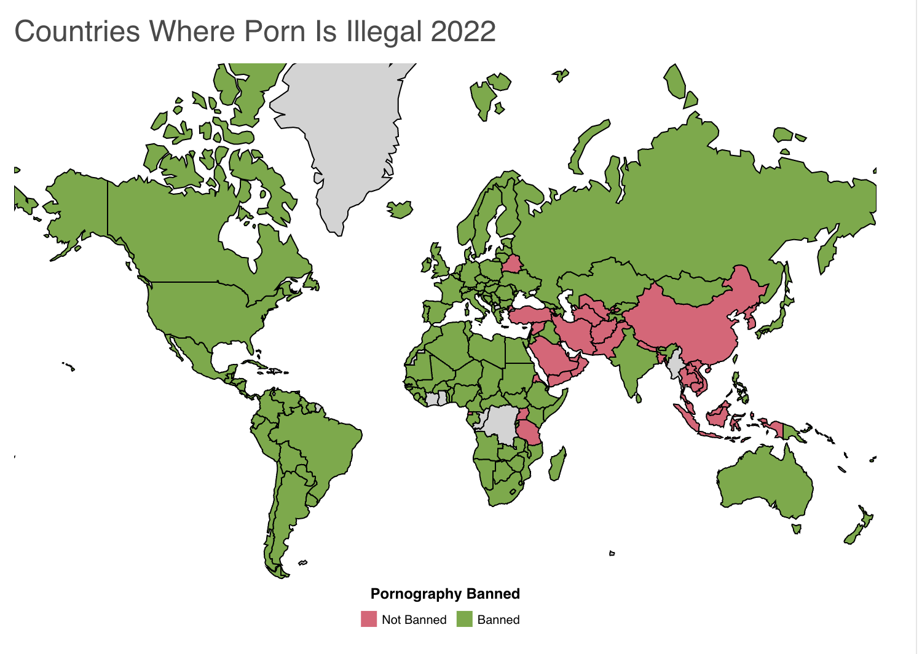
Bad Data Presentation of the Week

Slide 4
Bad Design – Common Problems
Poor choice of chart type
Information overload
Misleading scale
Missing axis labels or scales
Incorrect labels
Incorrect data
Burying (not highlighting) key information
Inaccessible
Type too small
Poor color choices
Use of audio cues or messages
Meaningless (distracting) decoration & visual effects
Unclear (what does the graphic represent)
Poor aesthetics (ugly!)

Slide 5
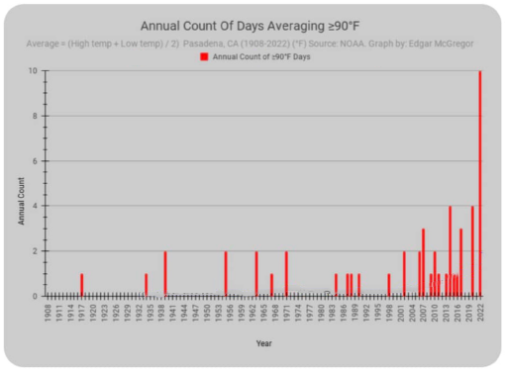
Featured Data Presentation of the Week

Slide 6
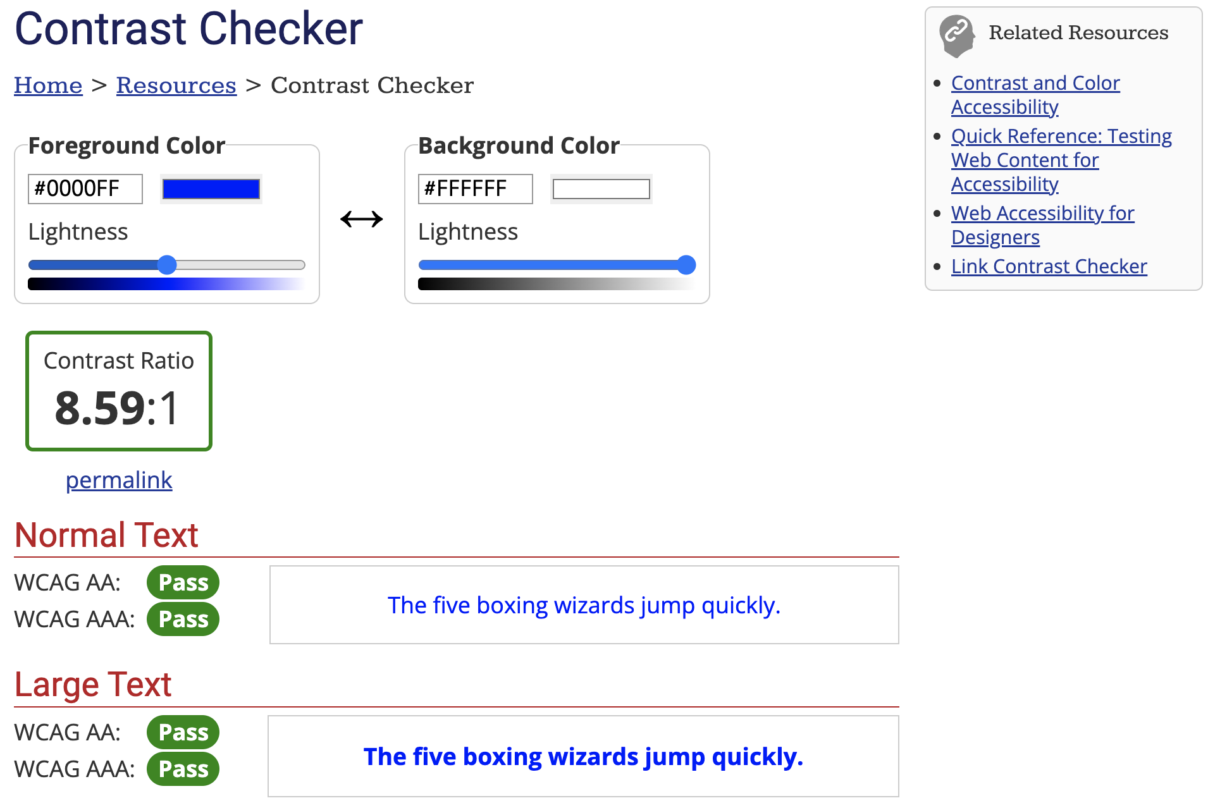
WCAG* Contrast Checker
https://webaim.org/resources/contrastchecker/
* Web Content Accessibility Guidelines

Slide 7
Use of Color
Because a significant number of people have impair color vision, colors should not in general be used as the sole distinguishing characteristic. Use different shades, patterns, or shapes.
To help you make good color choices, there are online tools that will allow you to simulate color vision impairment:
https://www.color-blindness.com/coblis-color-blindness-simulator/
https://pilestone.com/pages/color-blindness-simulator-1

Slide 8
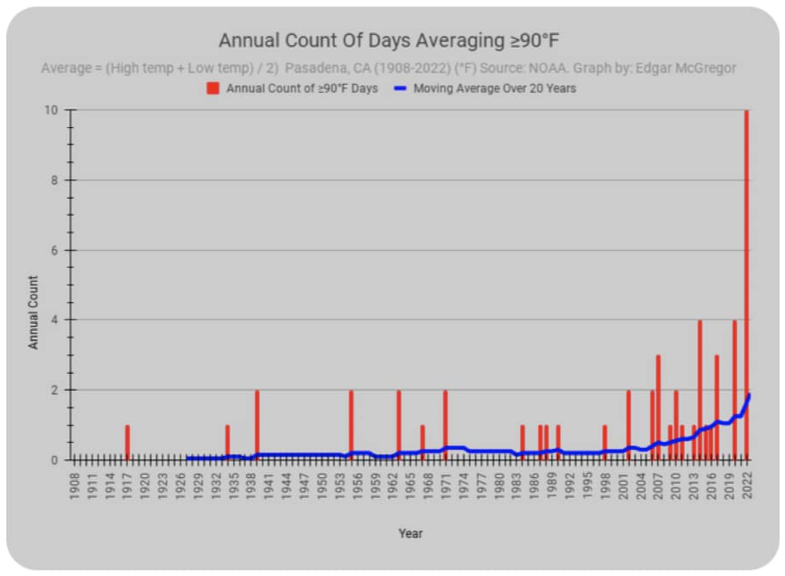
Featured Data Presentation of the Week

Slide 9
Look for Interesting Examples
If you find a noteworthy chart example, good or bad, send it to me:
To: robert.Nicholson@sjsu.edu
Subject: DATA 230 Example
Explain why you think it’s noteworthy
If I use it as a class example, I’ll give you 25 points (~1/4 of a homework assignment)

Slide 10
Splunk for Data Visualization

Slide 11
Data Collection
From the second lecture:
Aggregating data from multiple sources
Monitoring real-time data
Automating data collection

Slide 12
What is Splunk?
Splunk is a software platform to search, analyze and visualize big-data or machine-generated data gathered from the websites, applications, sensors, devices, etc.
Download a 60-day Splunk trial:
https://www.splunk.com/en_us/download.html
When launched, Splunk runs in your web browser

Slide 13
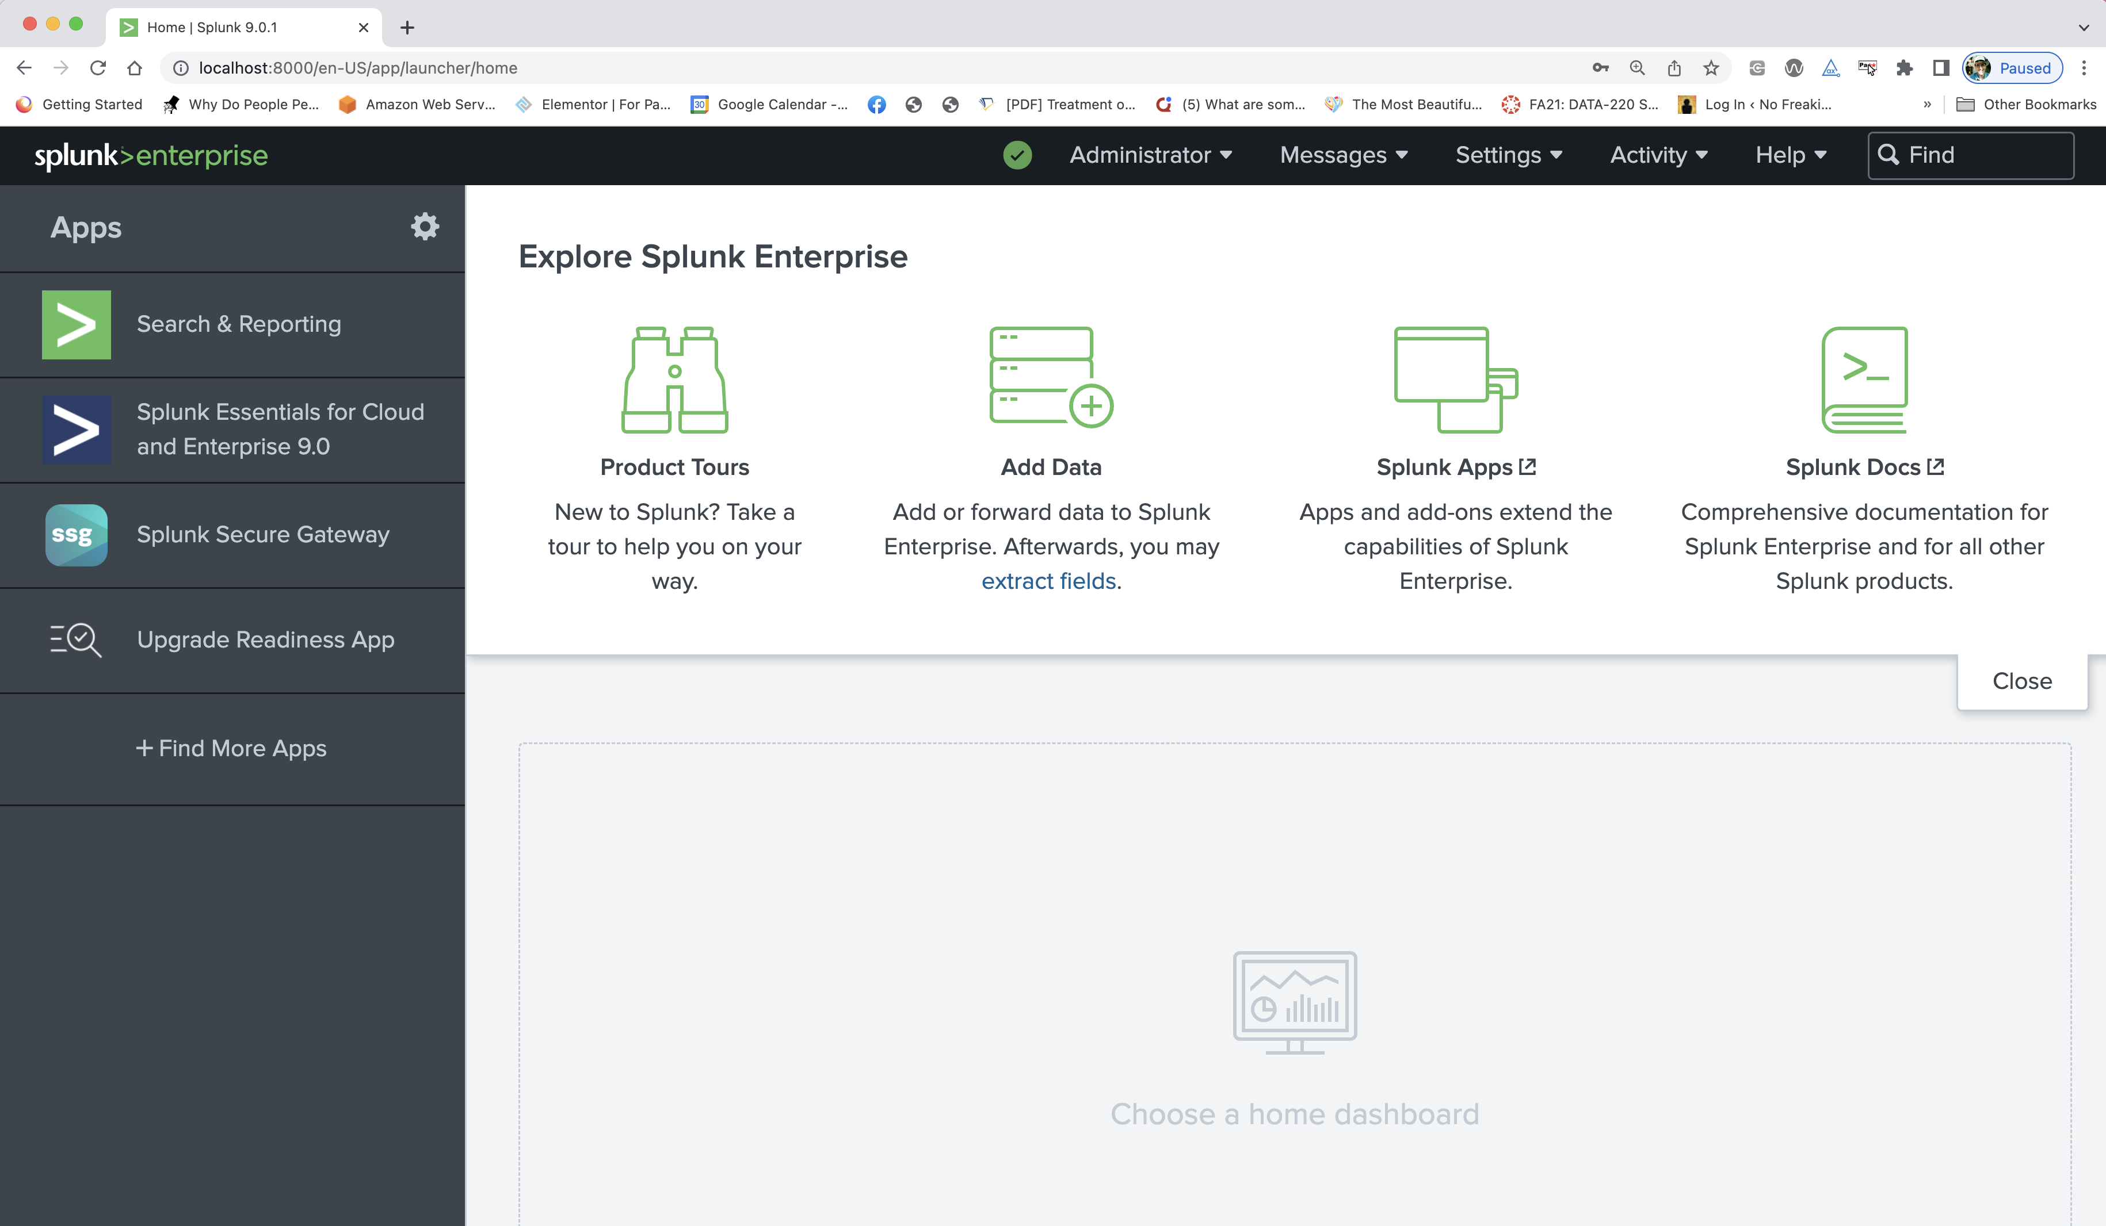
Splunk in a Web Browser

Slide 14
Real-Time / Ongoing
Splunk gathers an aggregates data from multiple sources in real-time (as it happens)
Data analysis steps are programmed and automated
Produces graphs, charts, visualizations, dashboards
Integrated with major business apps such as Salesforce
Competitors
SolarWinds, Riverbed, ManageEngine, IBM SevOne, Nagios

Slide 15
A Complex Product
Typically used in a TEAM environment
Programmer / IT specialist
Marketer
Data Scientist
Graphic Designer
Etc
Requires Training

Slide 16
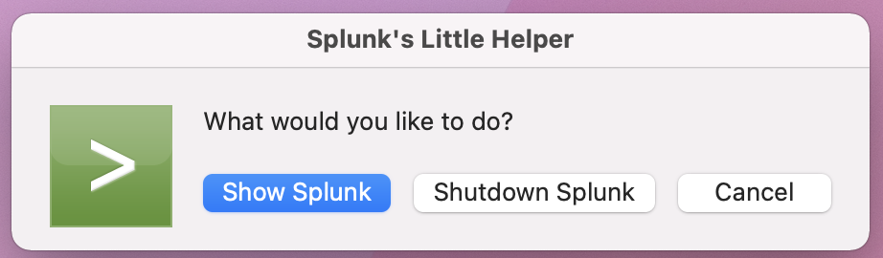
Install & Launch Splunk
After you click Show Splunk, the Splunk Control Panel will open in a browser window

Slide 17
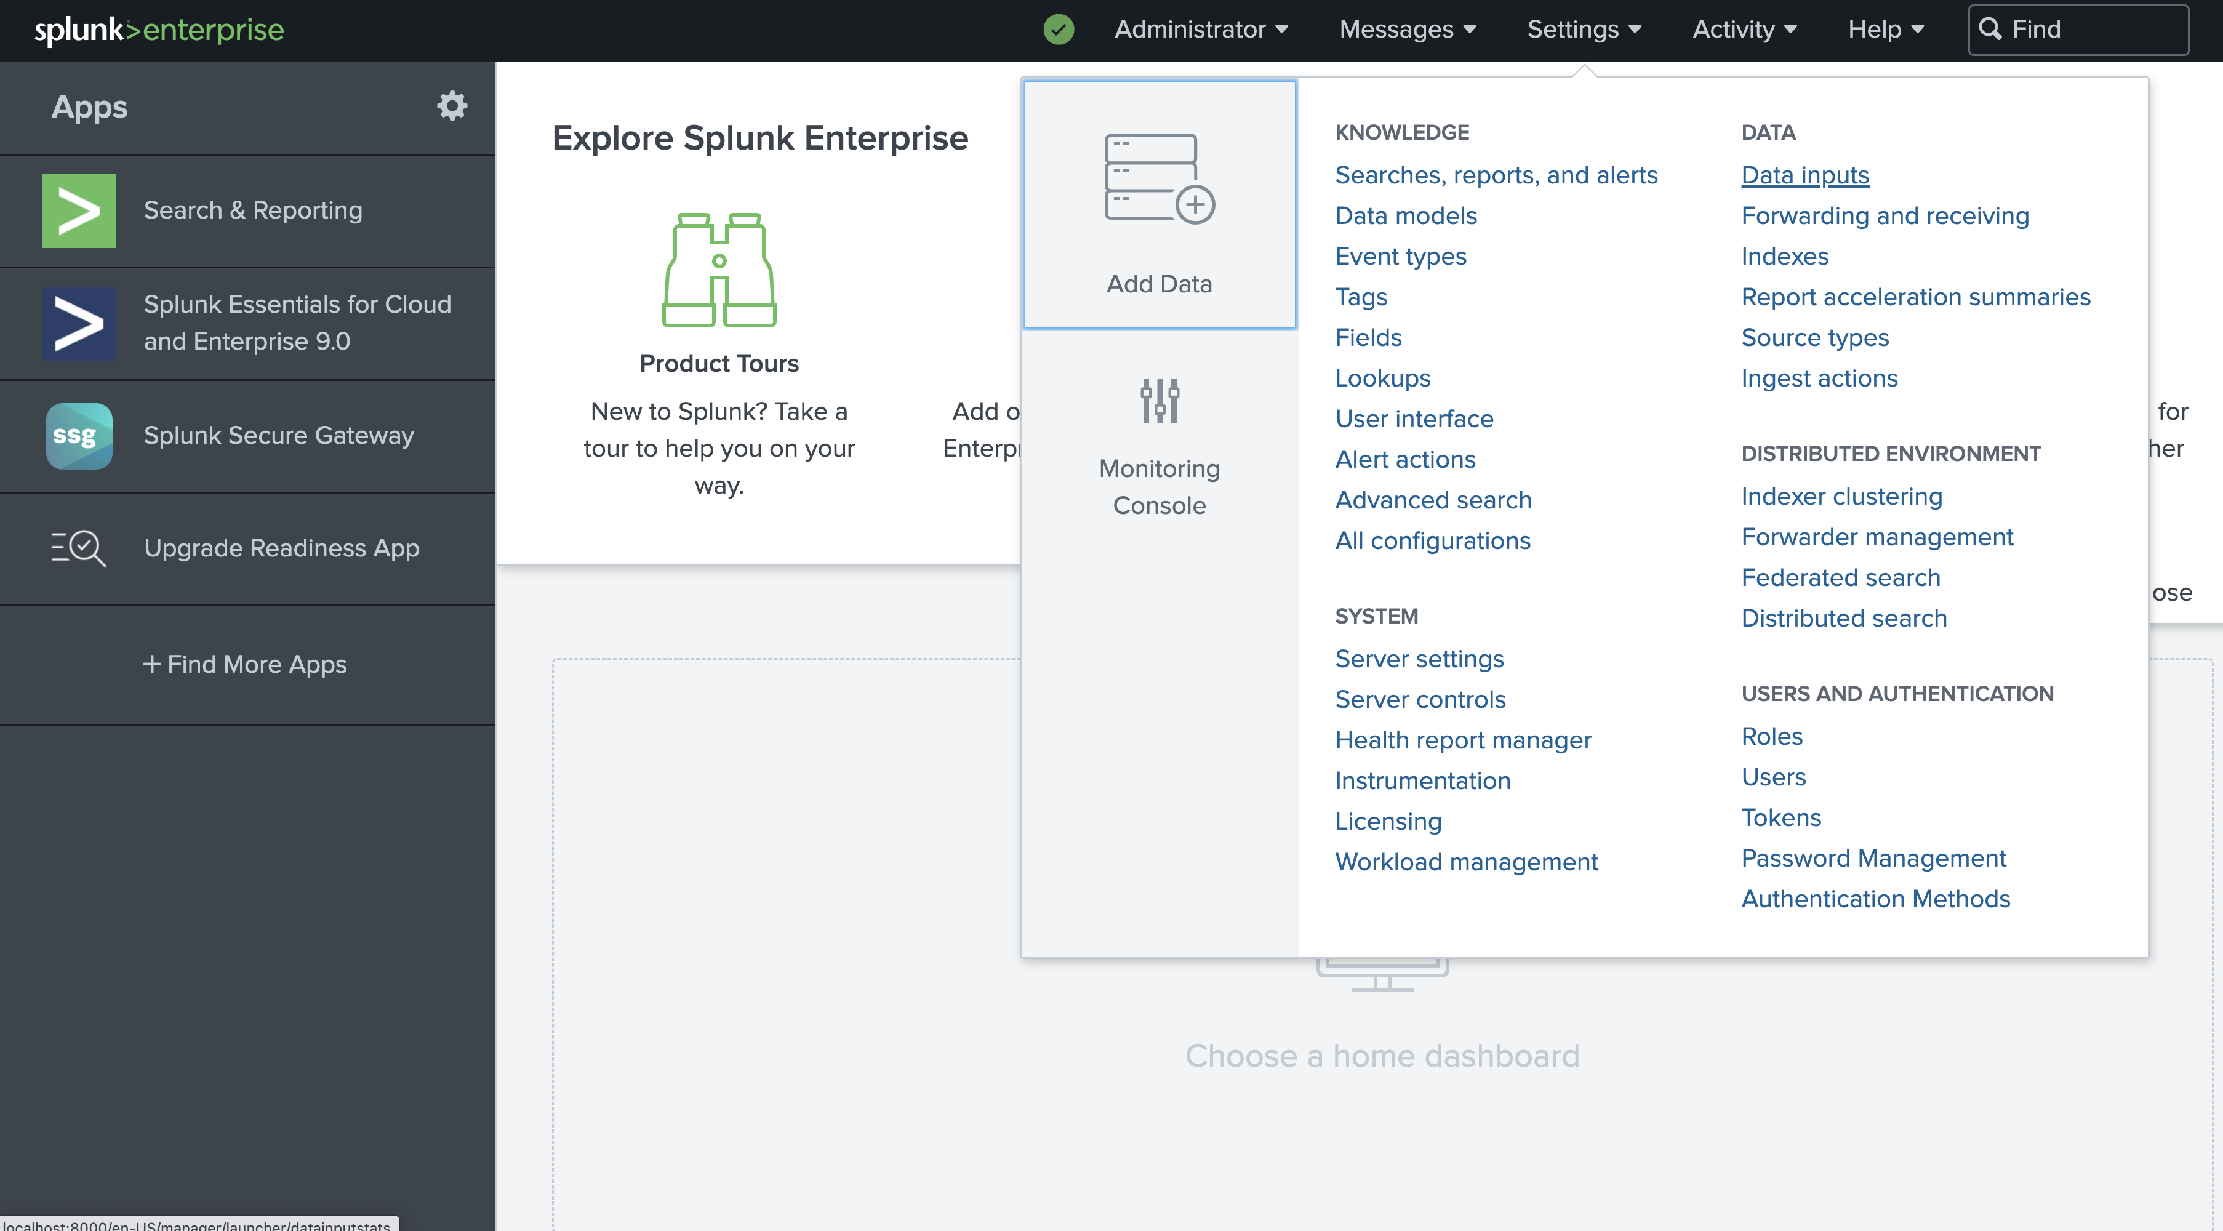
The Settings Menu

Slide 18
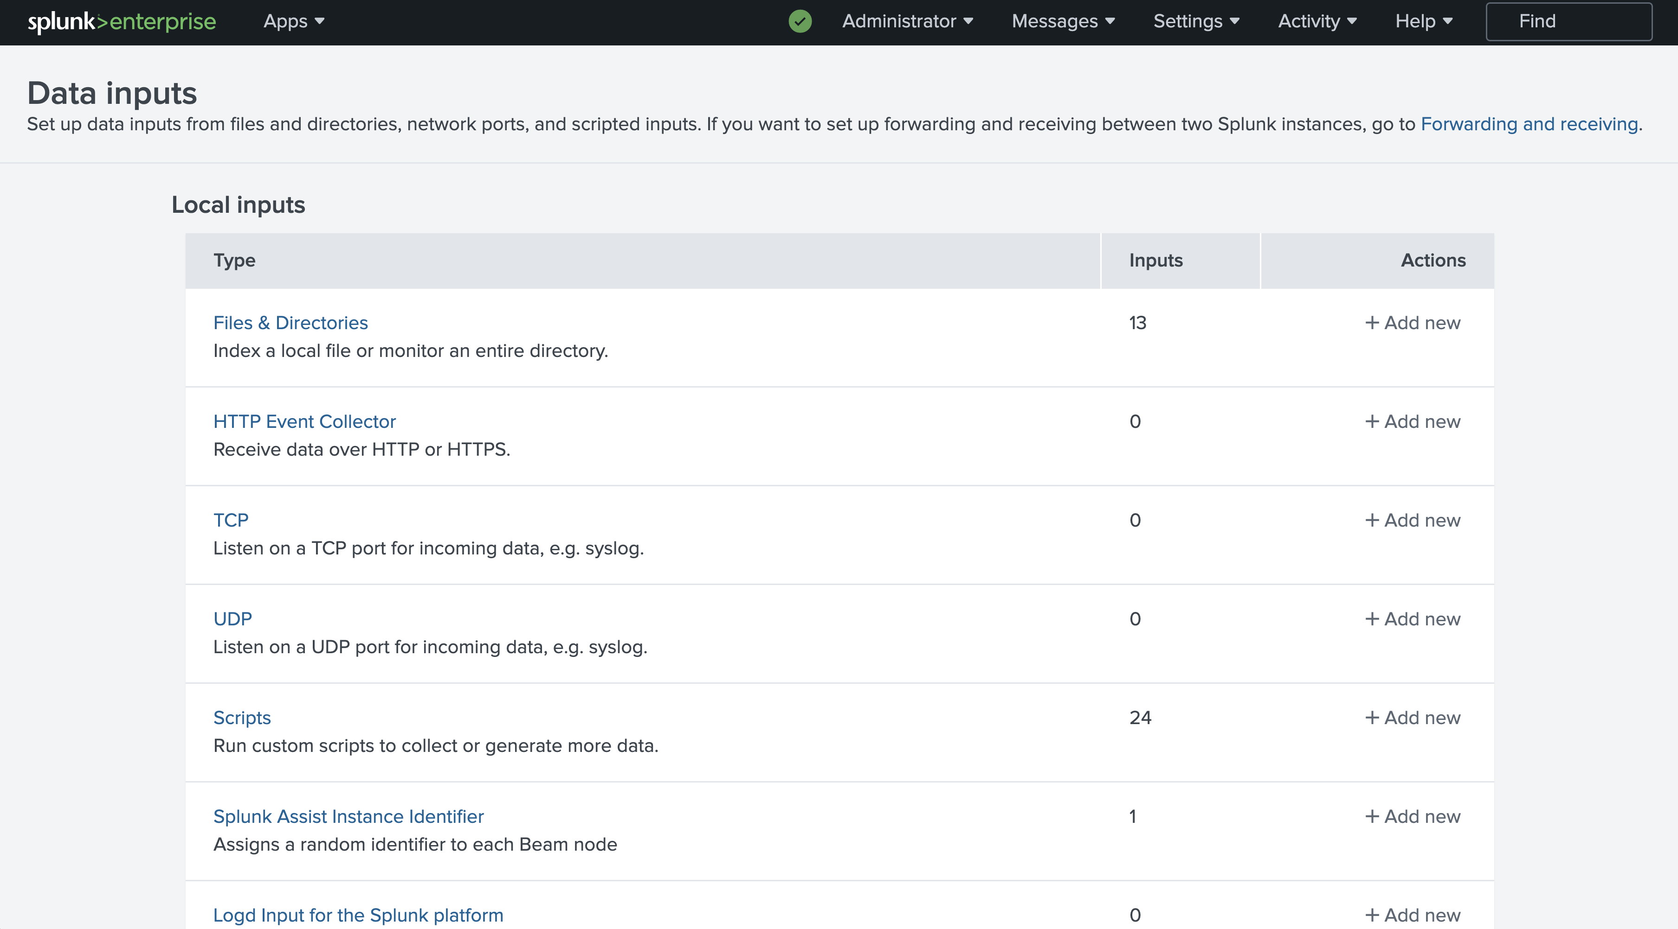
Selecting an Input Type

Slide 19
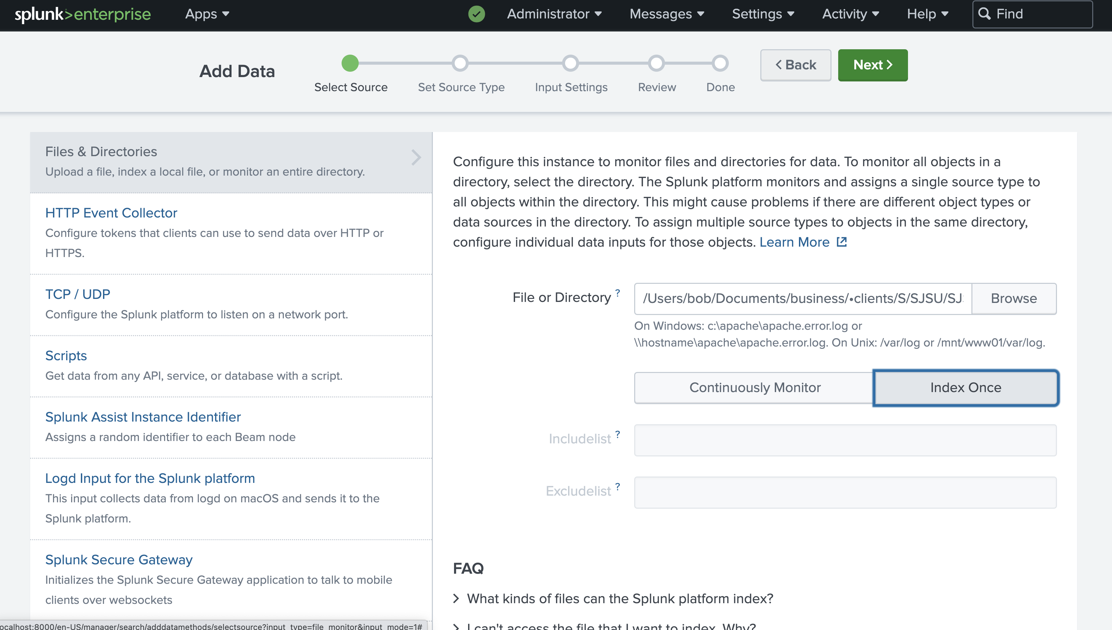
Loading a Local File

Slide 20
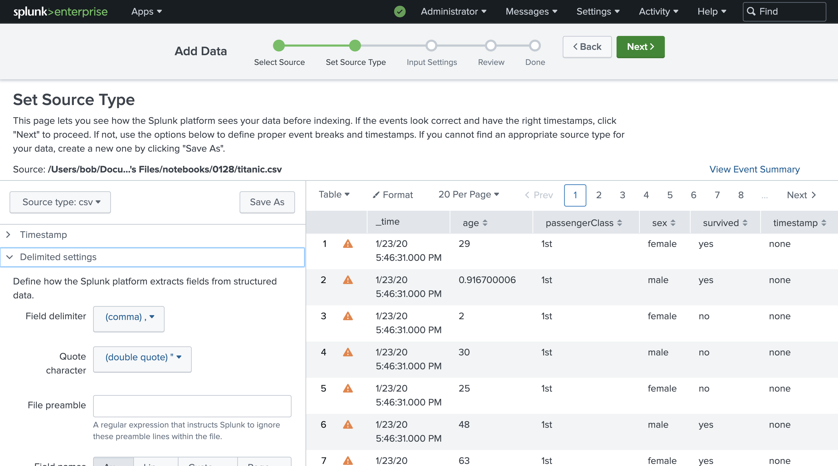
The Titanic Dataset (.csv file)

Slide 21
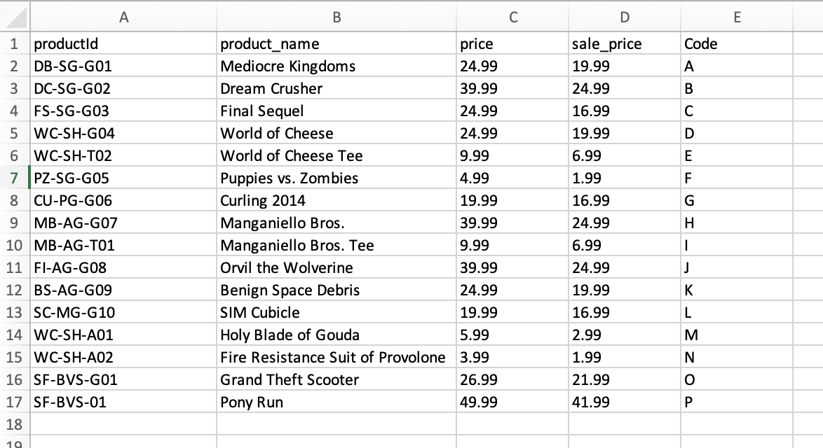
EXAMPLE
prices.csv

Slide 22
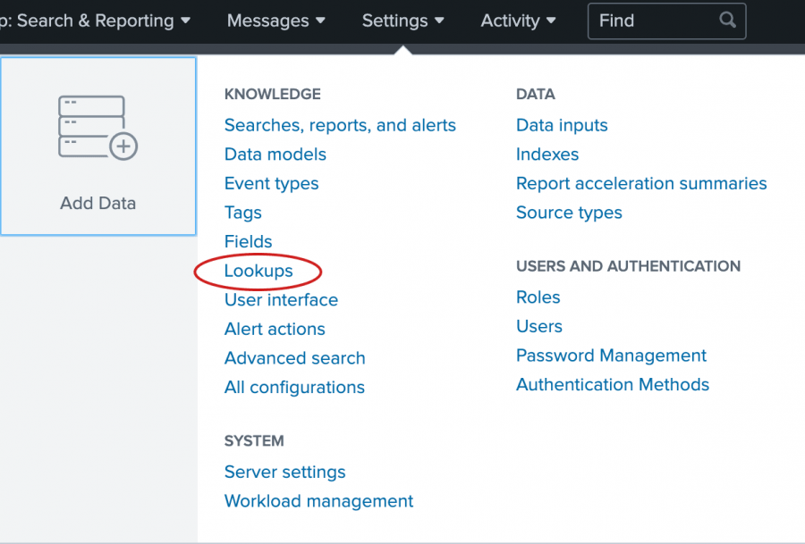
Building “Lookups”

Slide 23
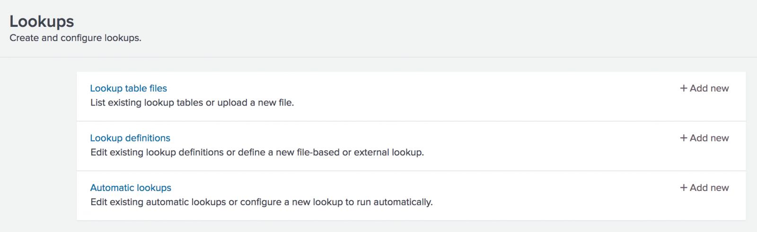
Lookup from a File

Slide 24
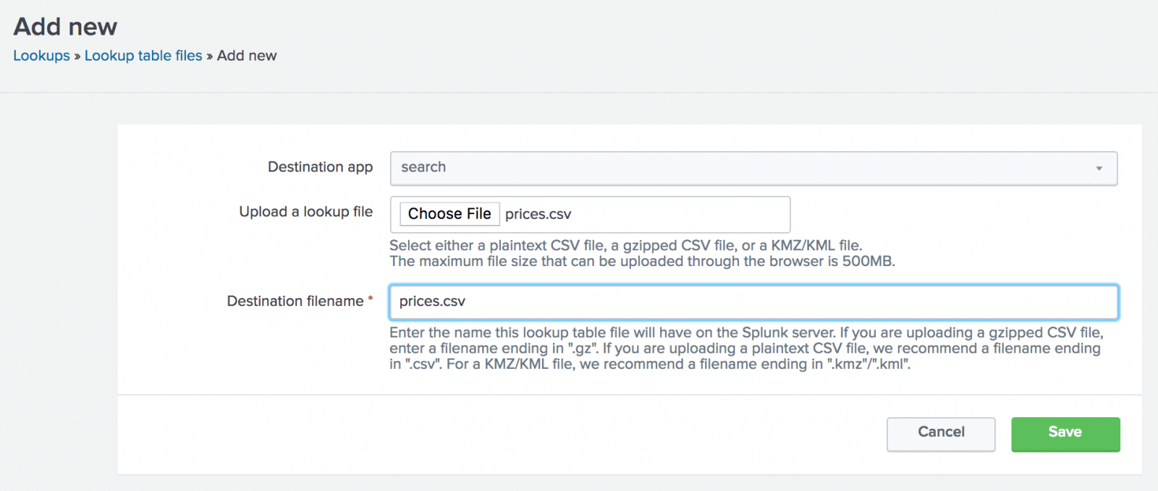
Load the File

Slide 25
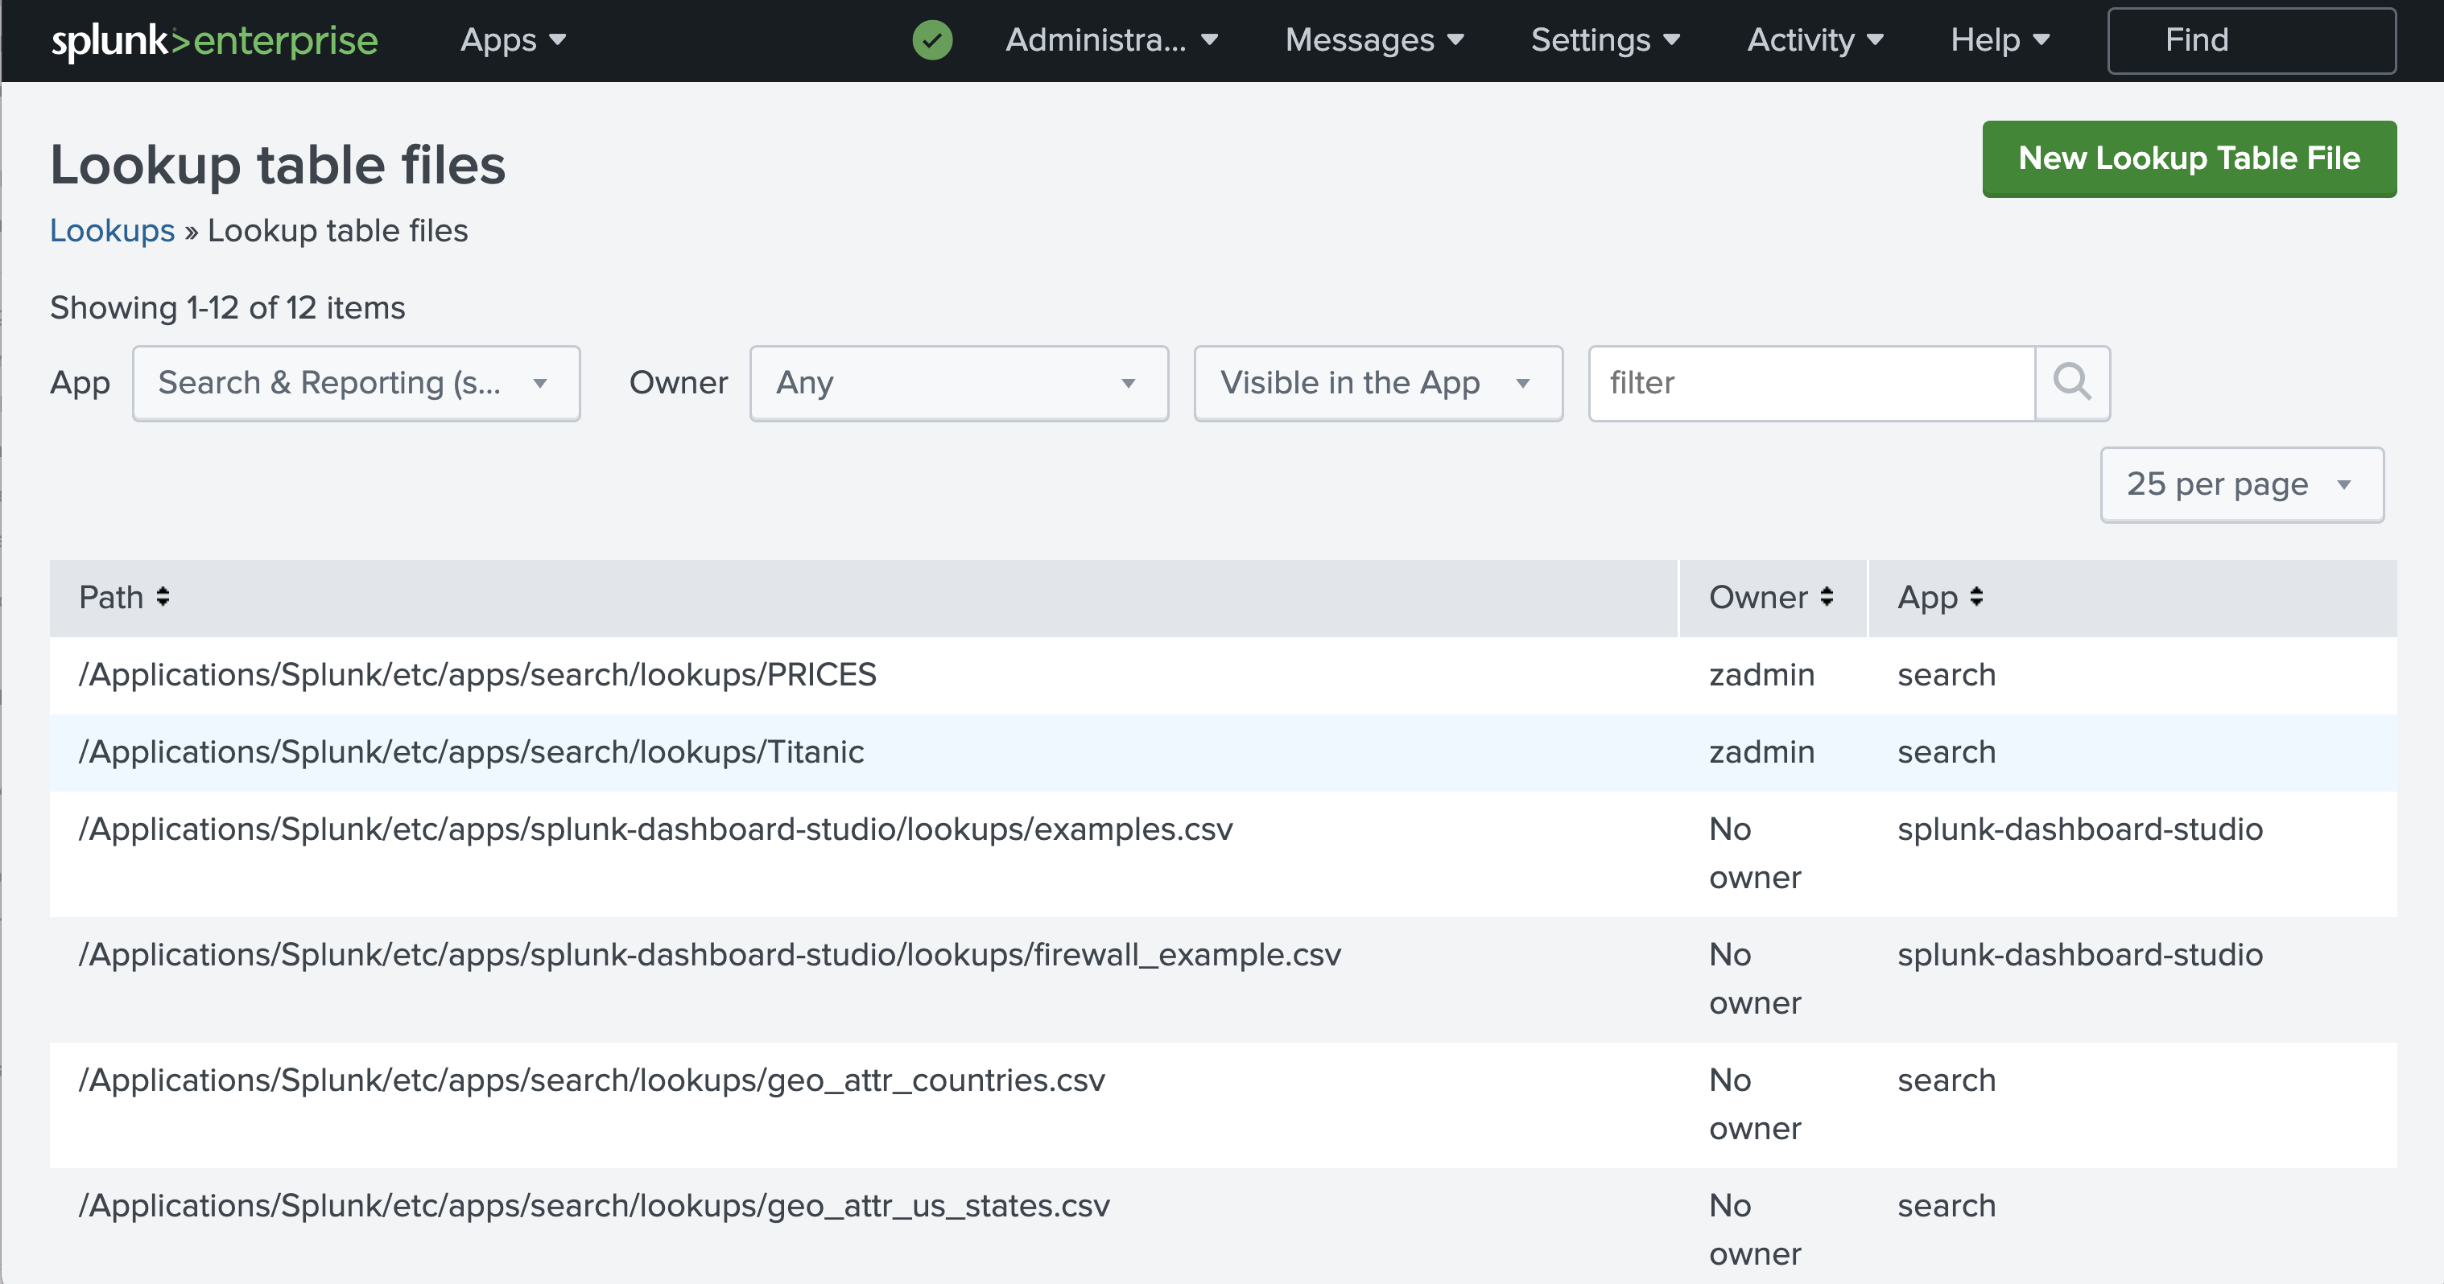
Widen Your Windows

Slide 26
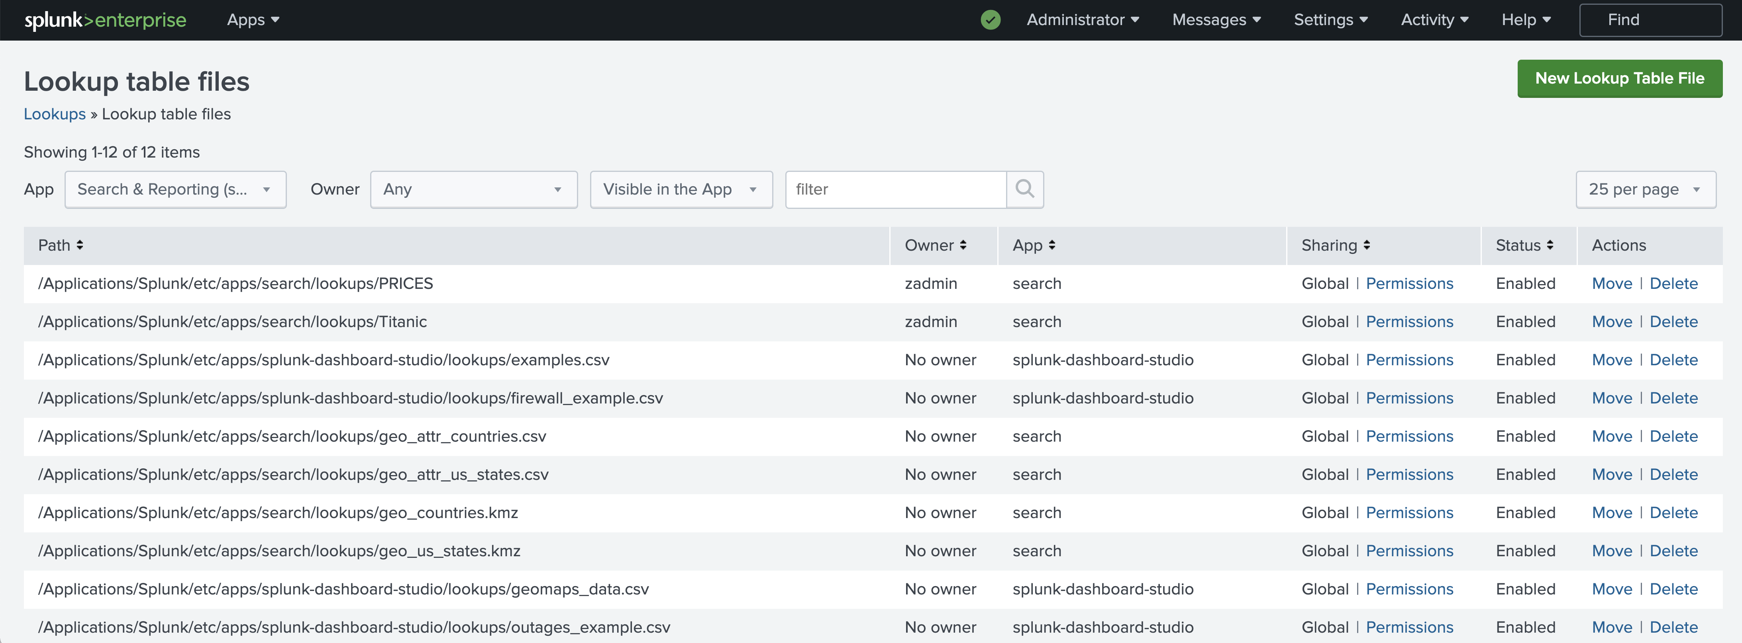
You’ll See a Lot More

Slide 27
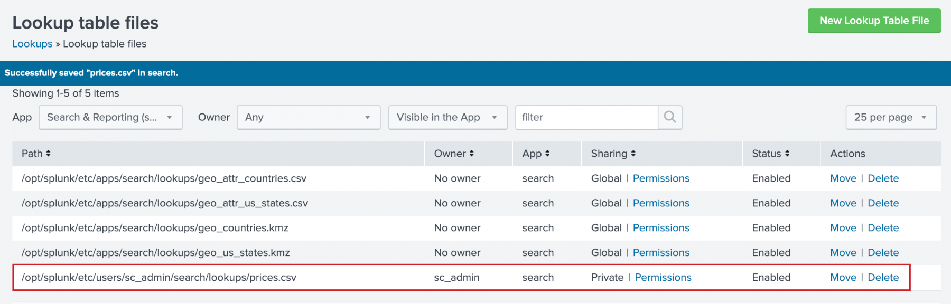
Set Permissions

Slide 28
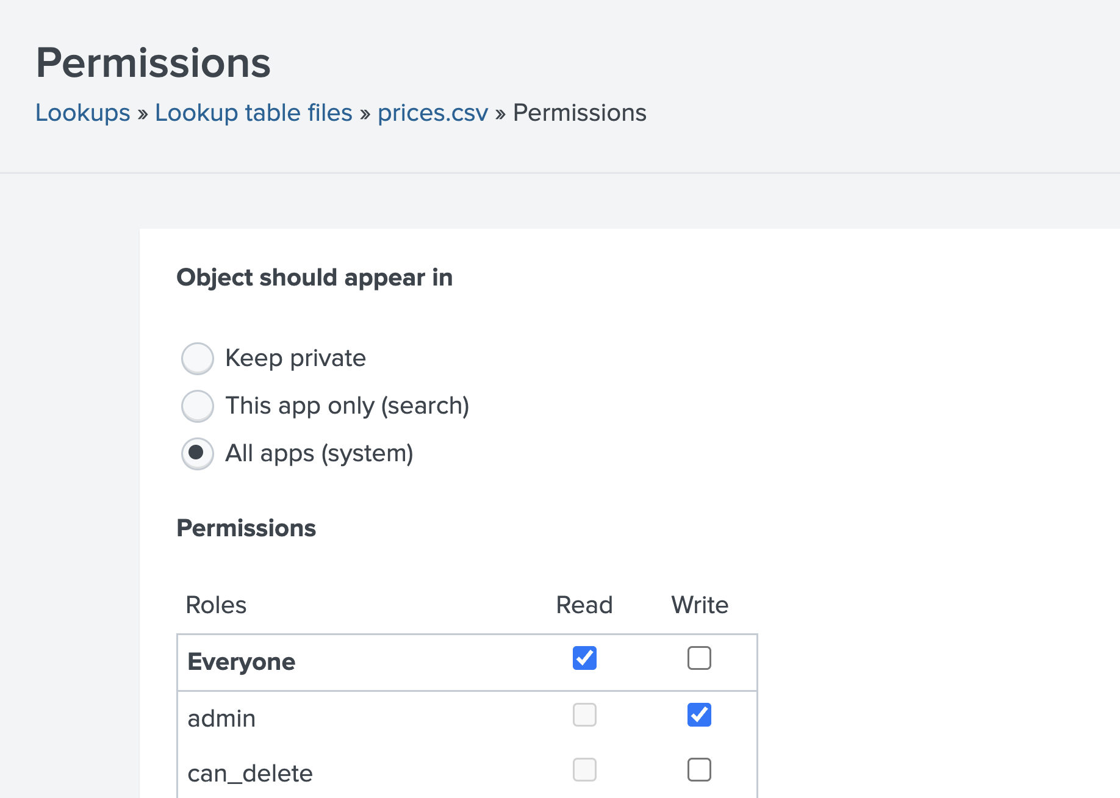
Default Permissions are Private

Slide 29
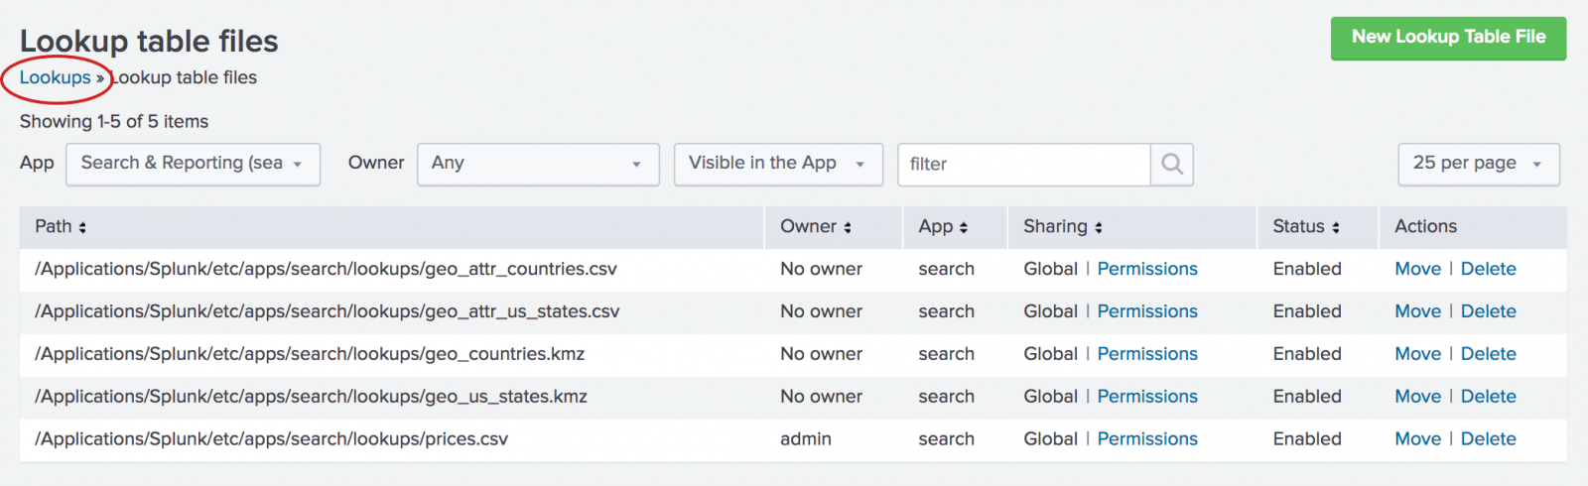
A Lookup ~ a Filter ~ a View

Slide 30
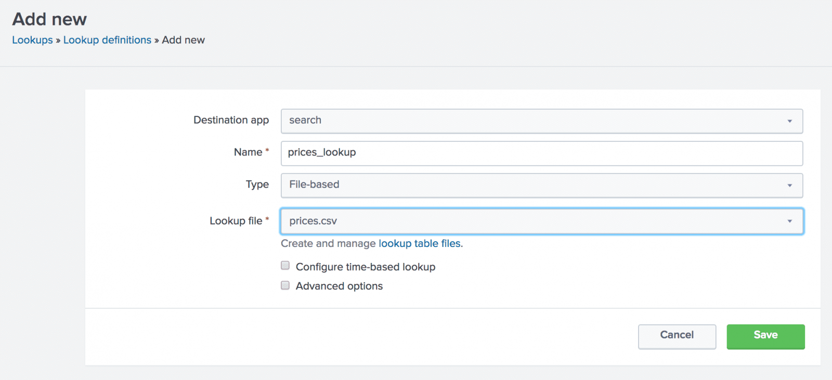
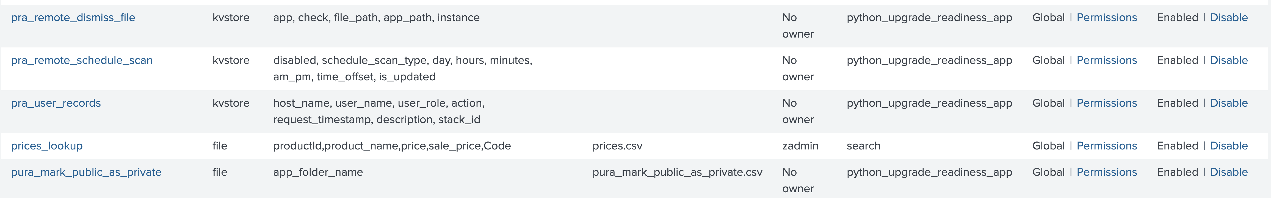
Add a Prices Lookup

Slide 31
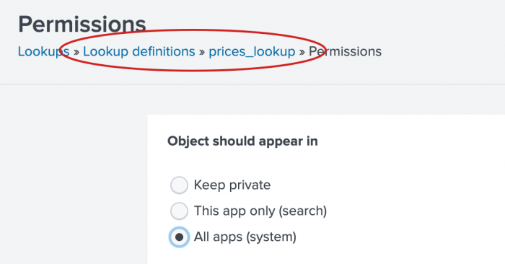
Set Permissions

Slide 32
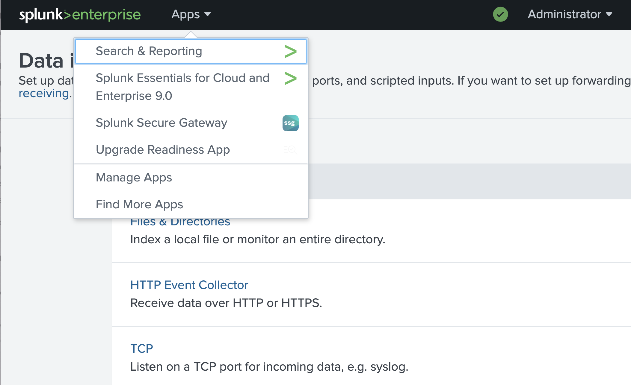
Launch the Search App

Slide 33
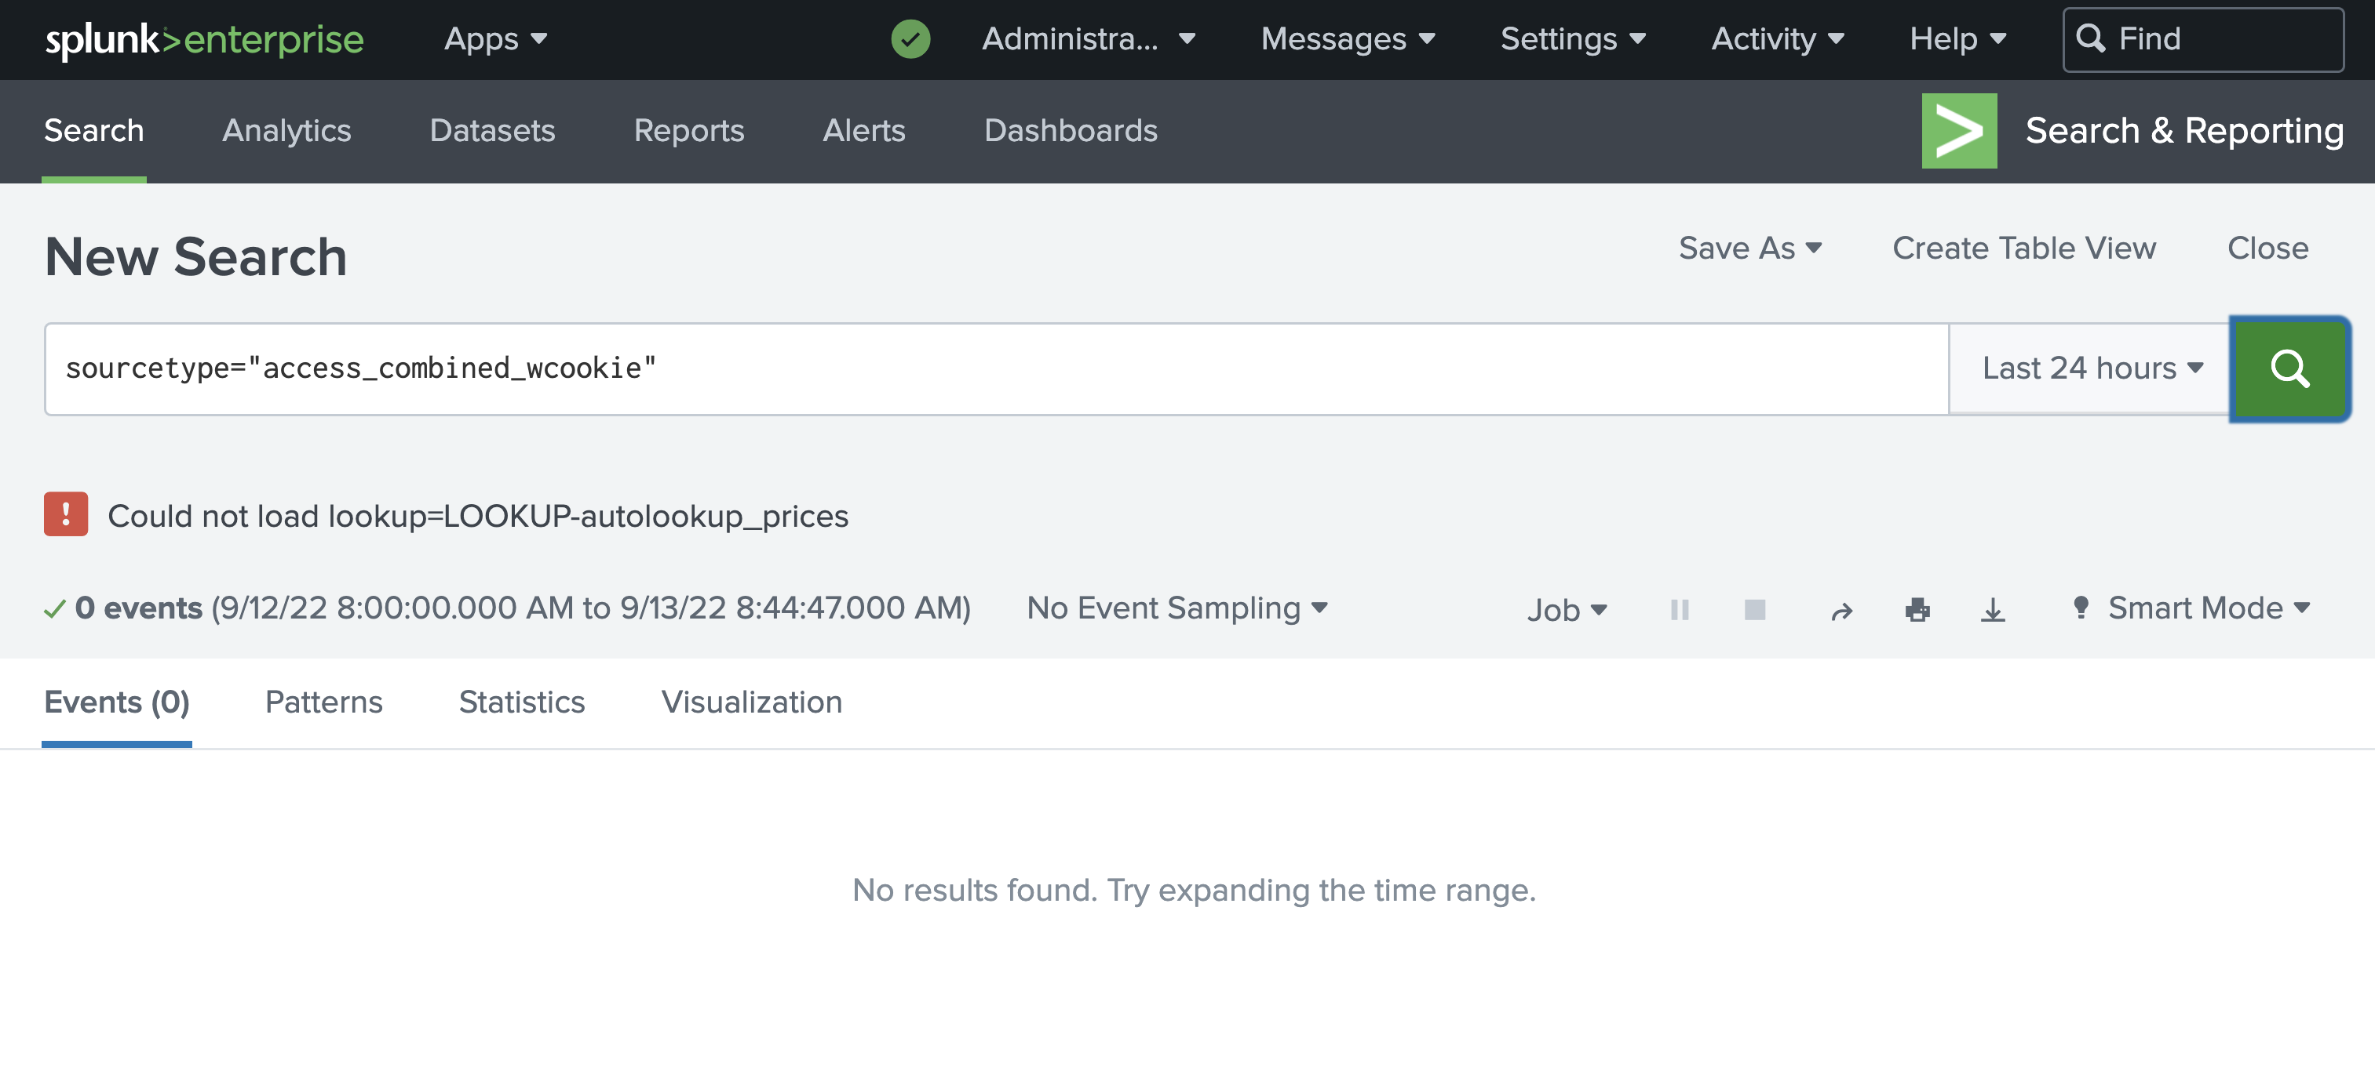
Run a Search

Slide 34
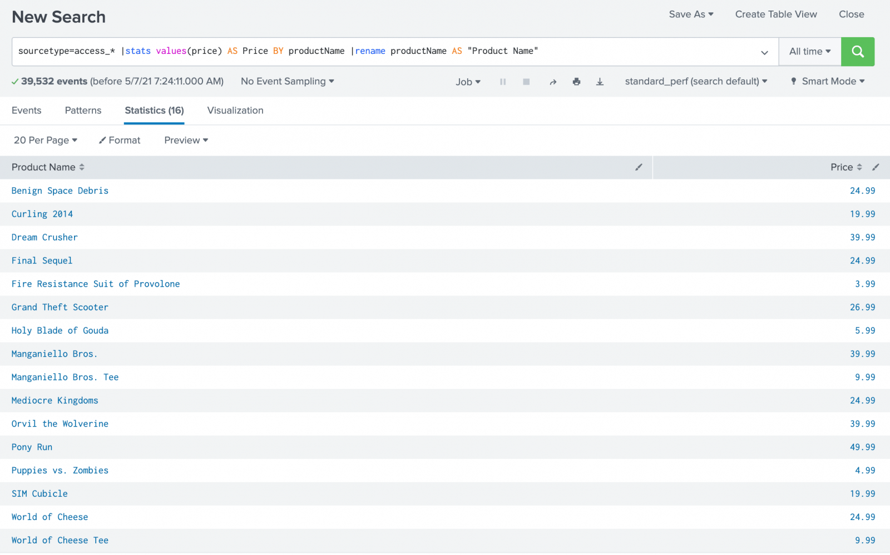
Try the Search Again

Slide 35
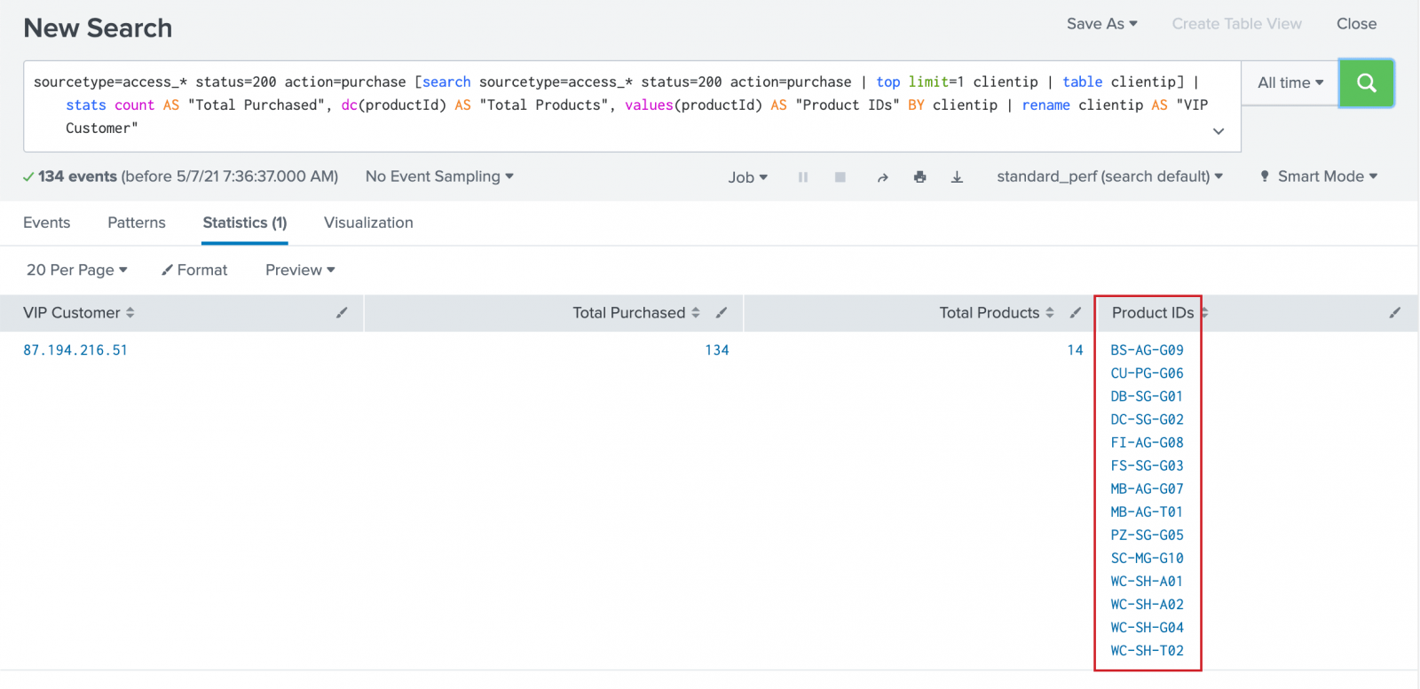
Another Search

Slide 36
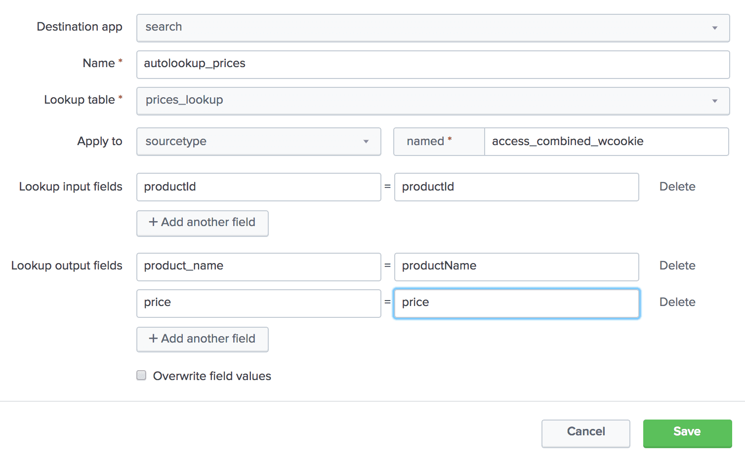
Create an Automated Lookup

Slide 37
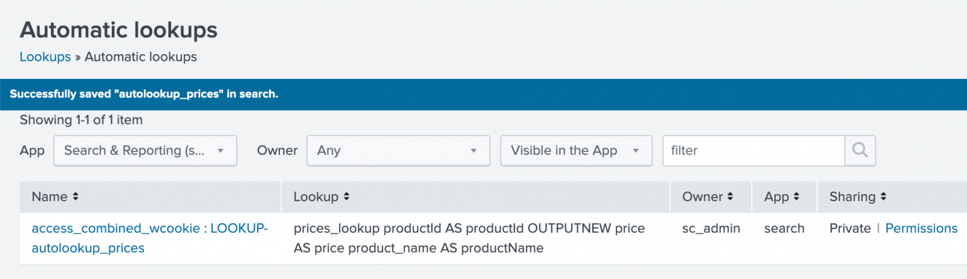
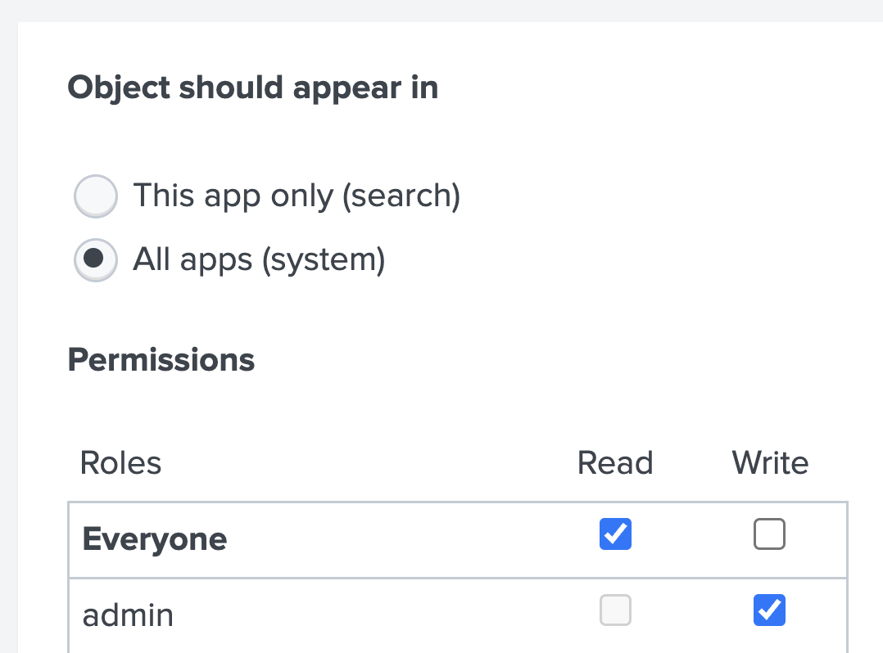
Generated Query
Don’t Forget Permissions:

Slide 38
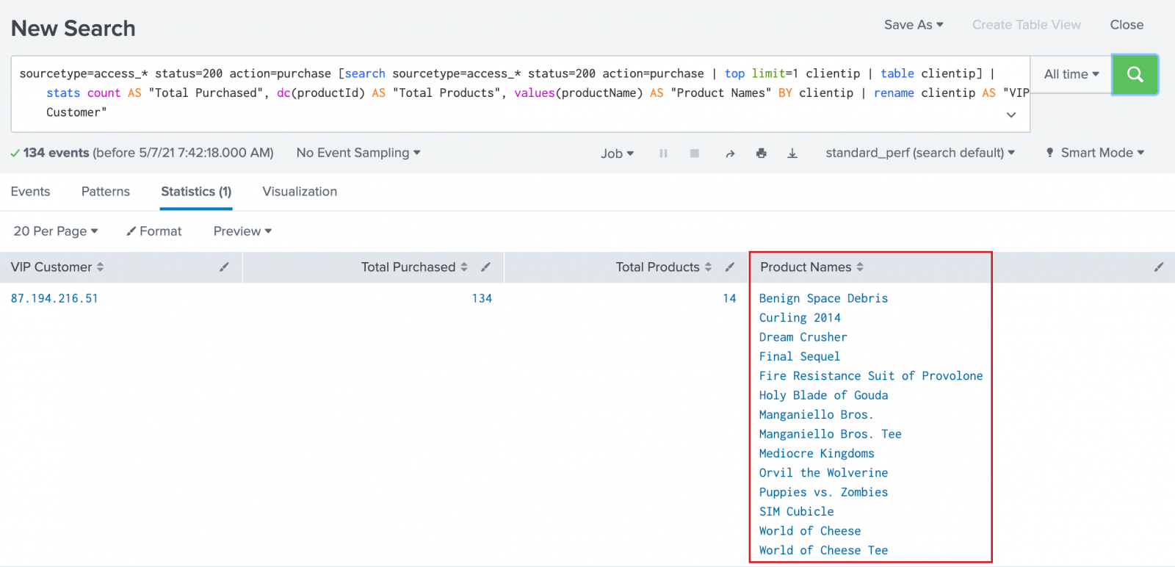
Combined Searches

Slide 39
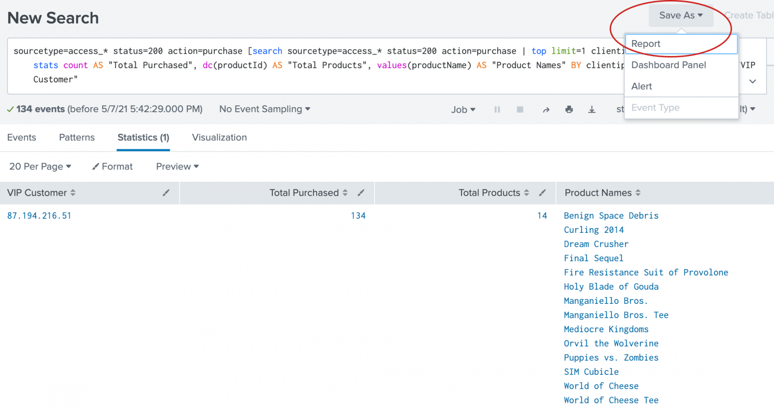
Saving a Report

Slide 40
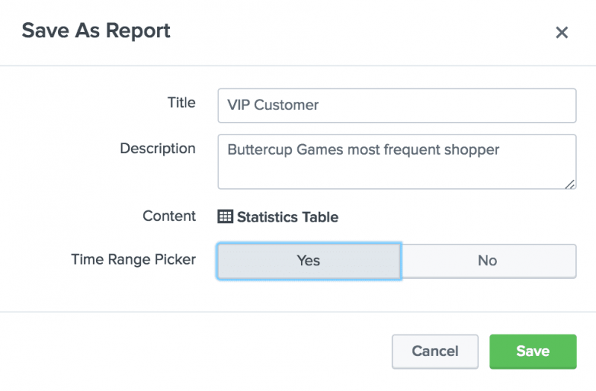
Saving a Report

Slide 41
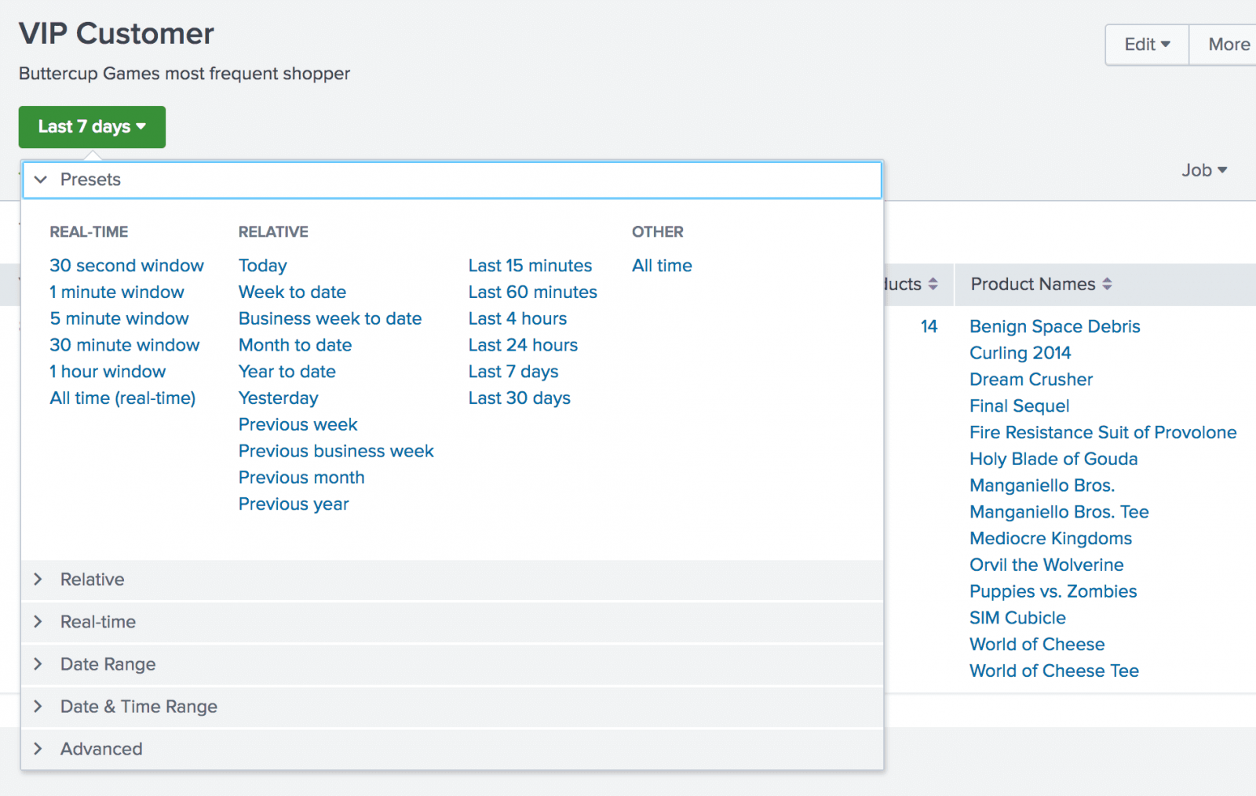
Running a Time Range Report

Slide 42
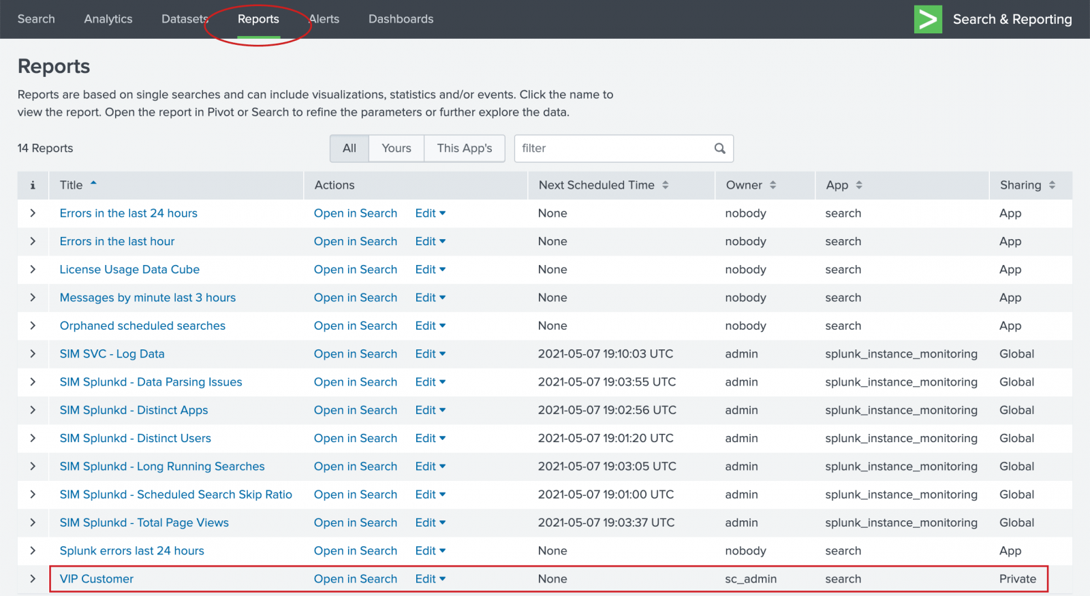
Sharing Reports

Slide 43
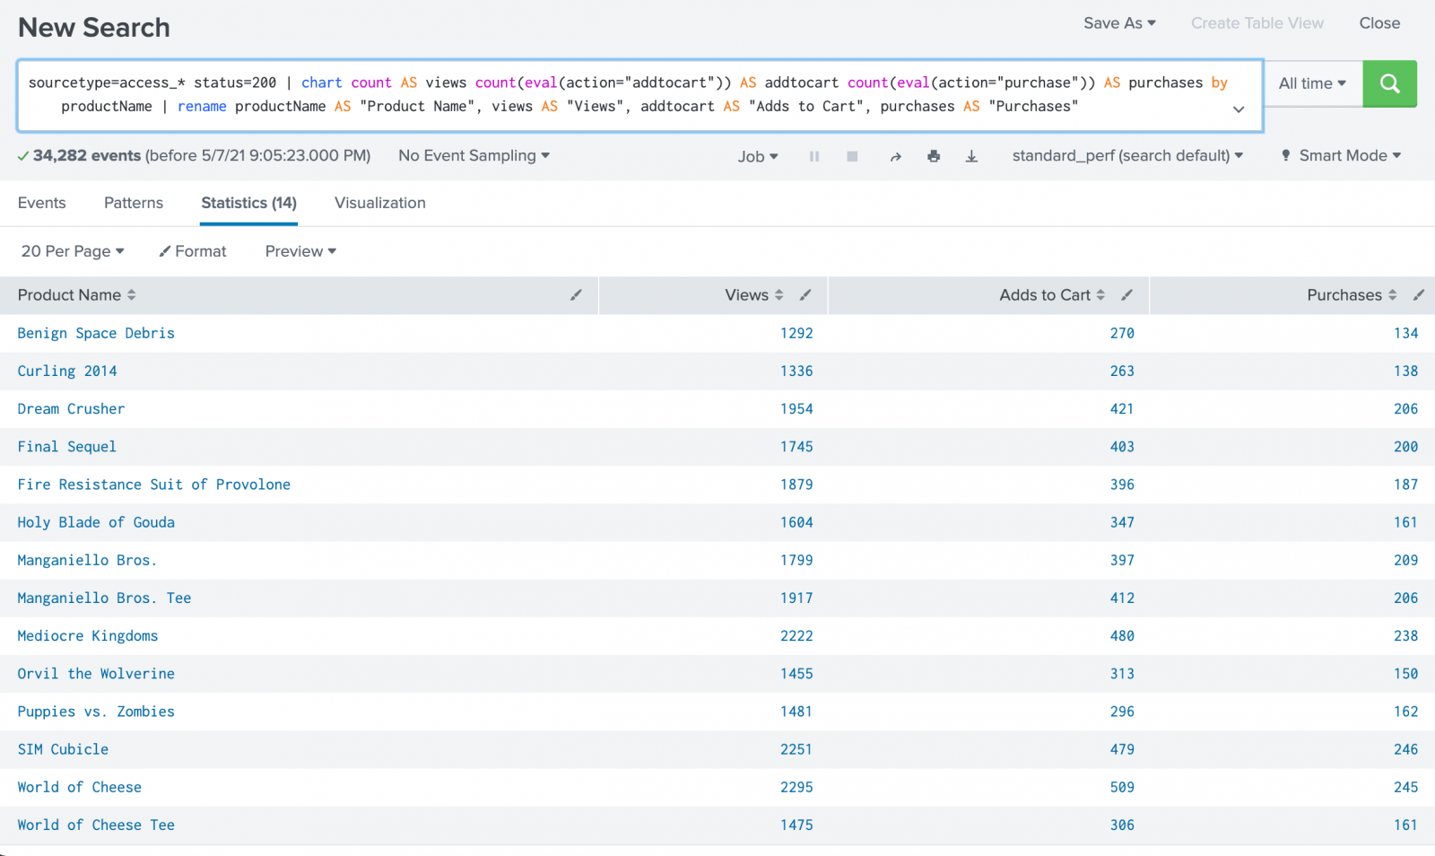
An Online Shopping Cart Report

Slide 44
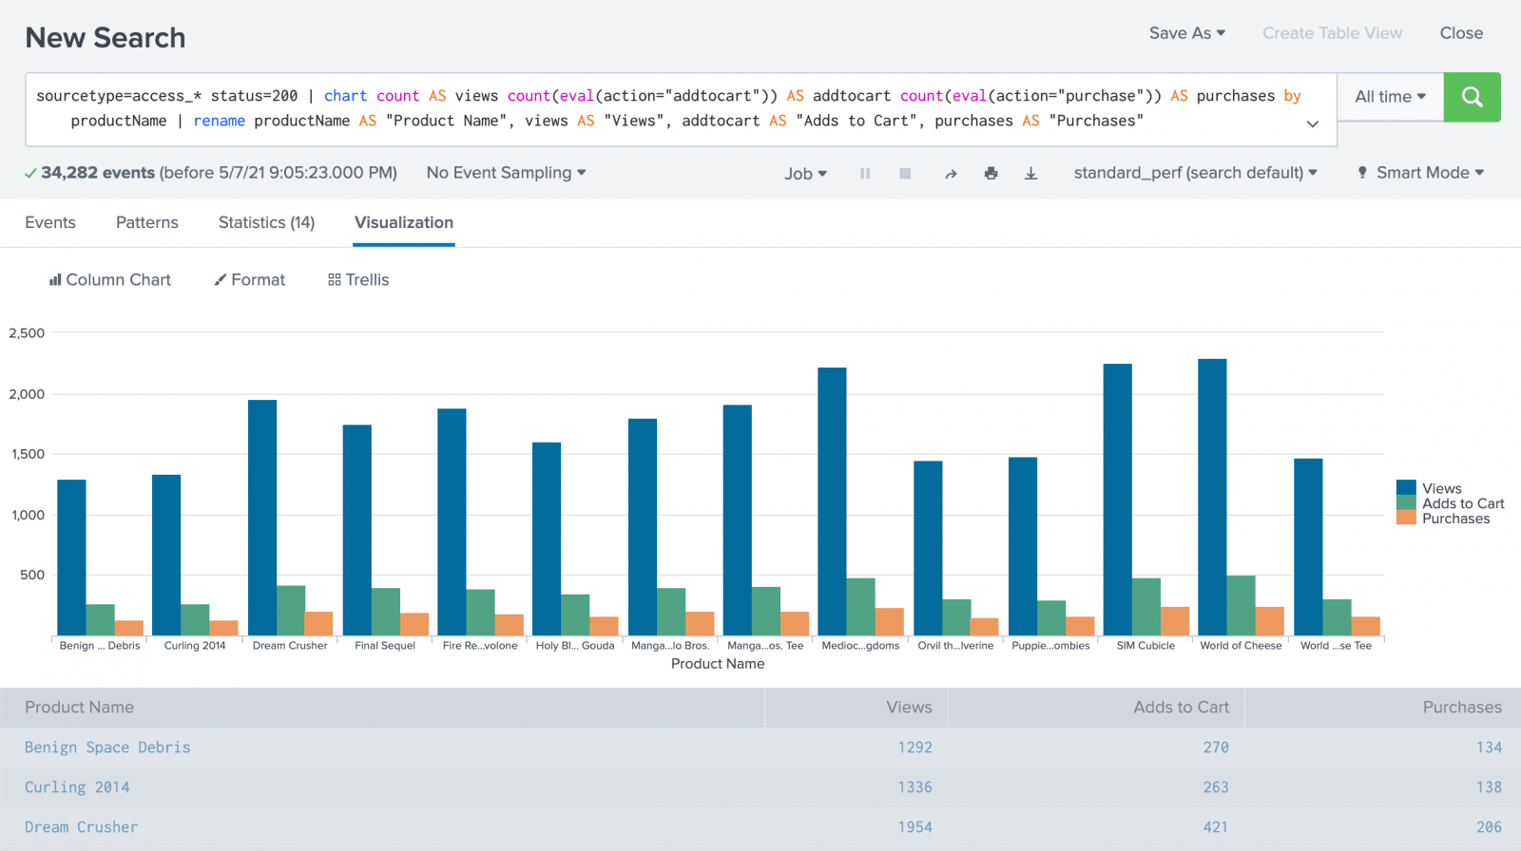
Click the Visualizations Tab

Slide 45
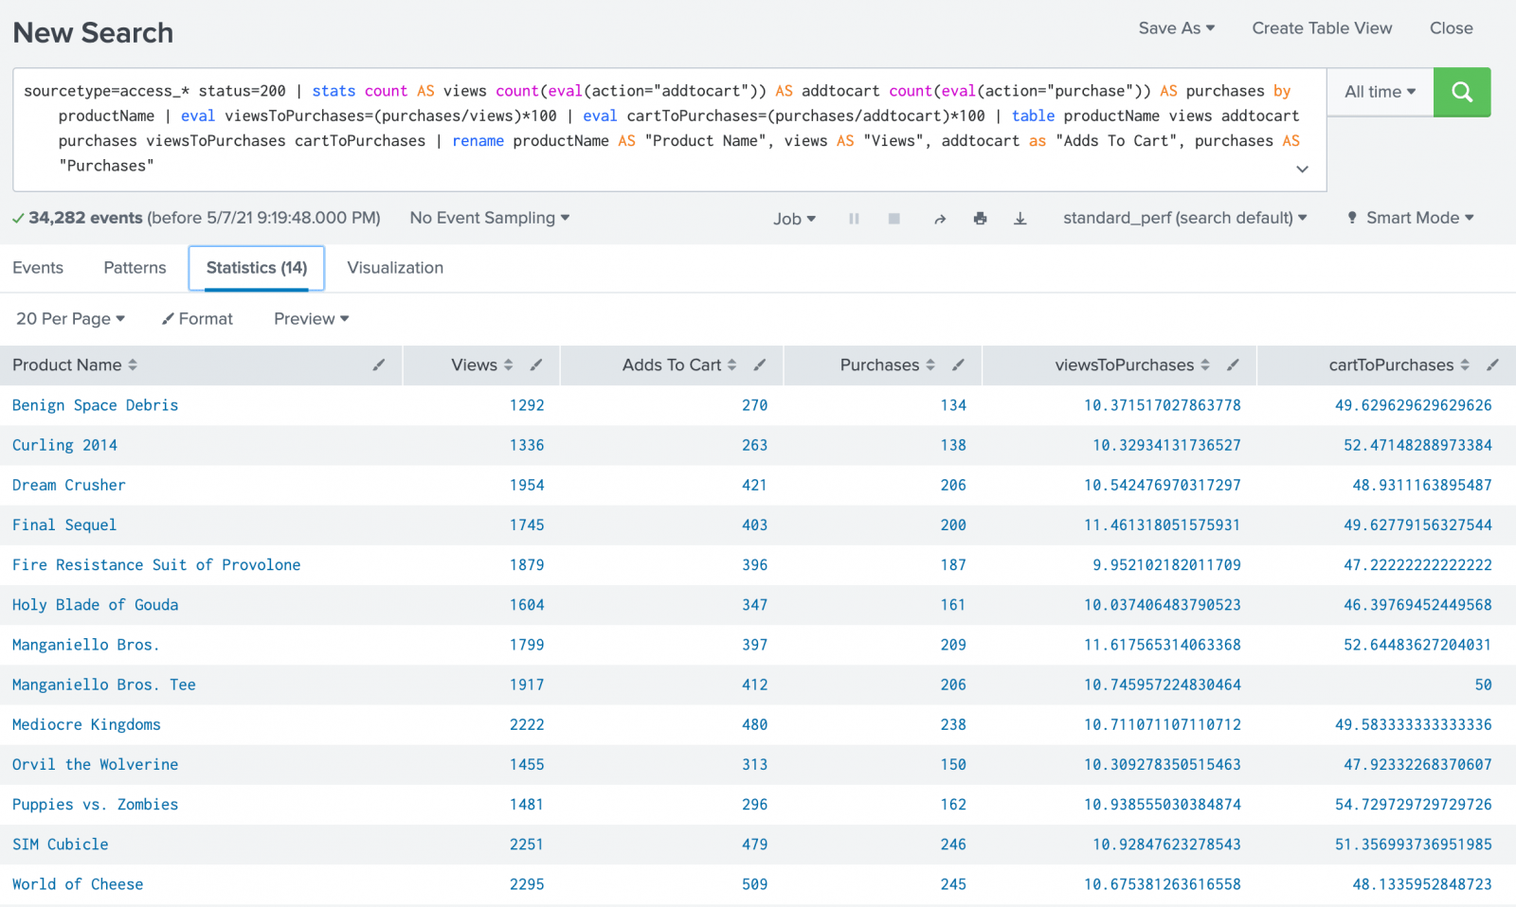
A More Complex Search

Slide 46
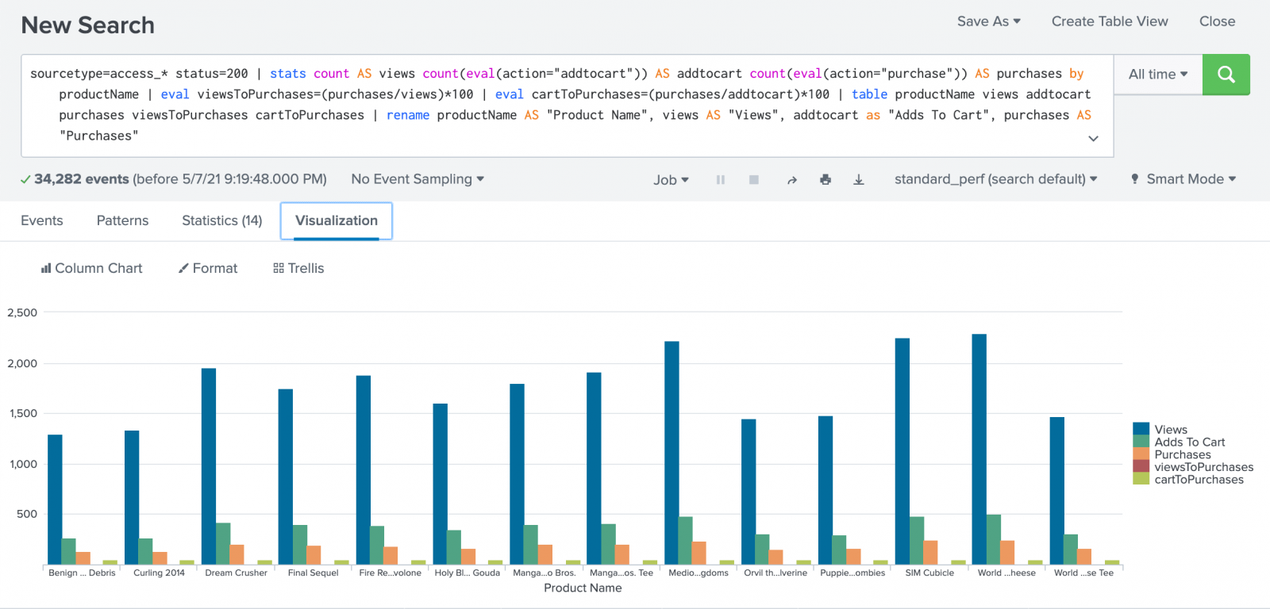
Visualization

Slide 47
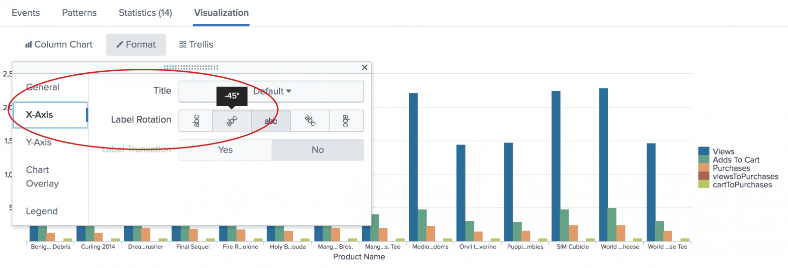
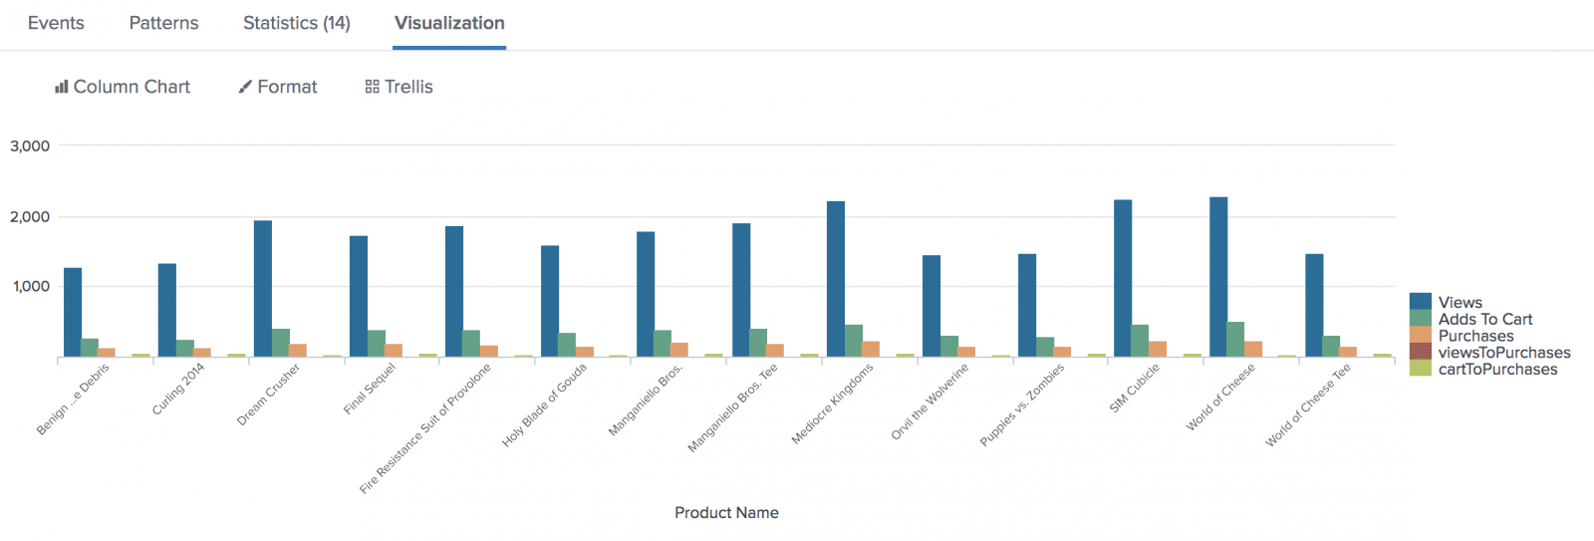
Formatting: X Axis

Slide 48
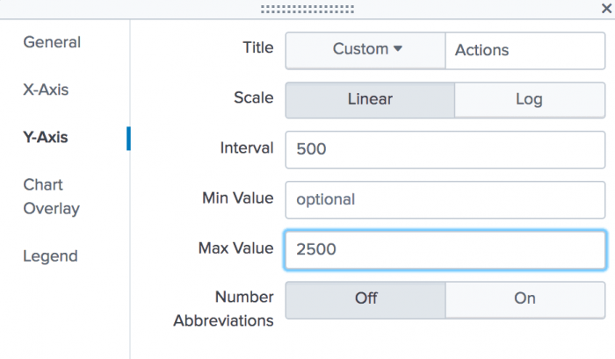
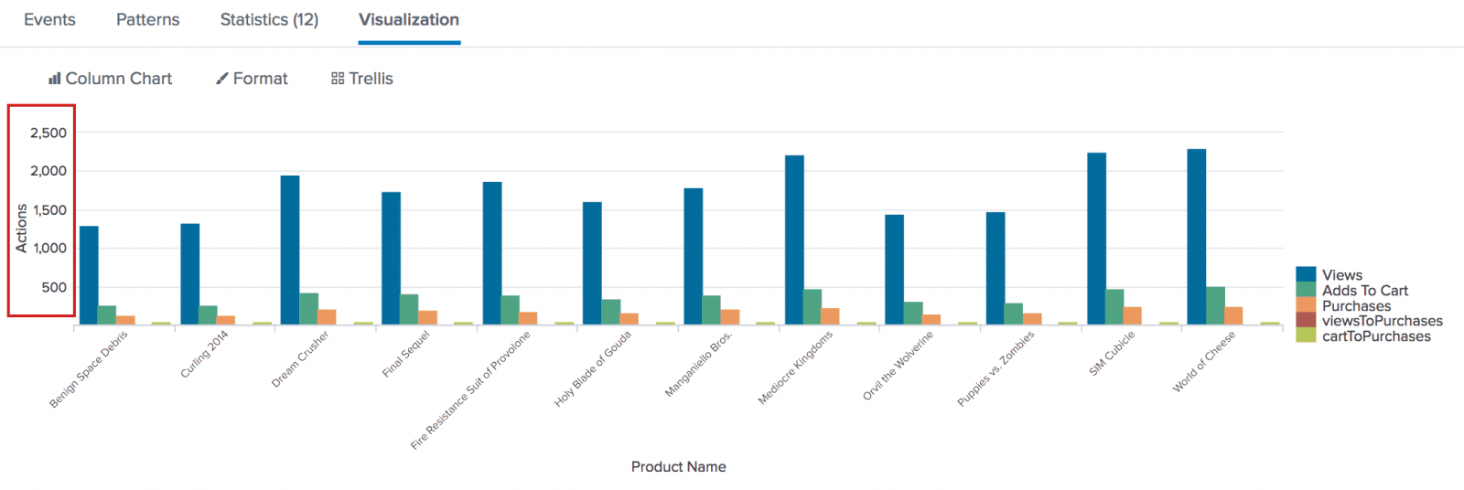
Formatting: Y Axis

Slide 49
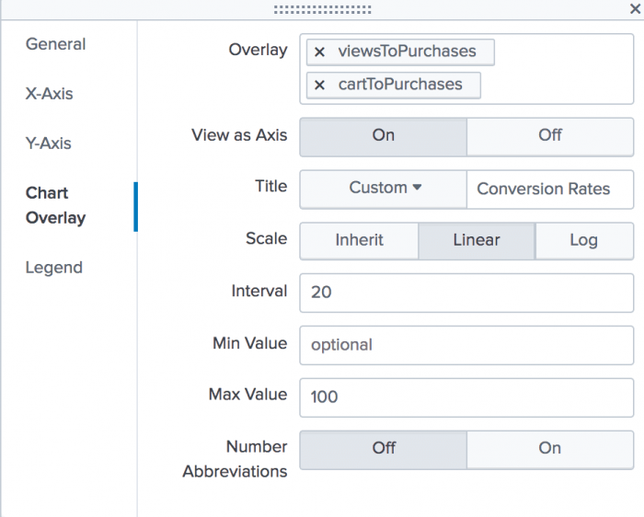
Creating a Chart Overlay

Slide 50
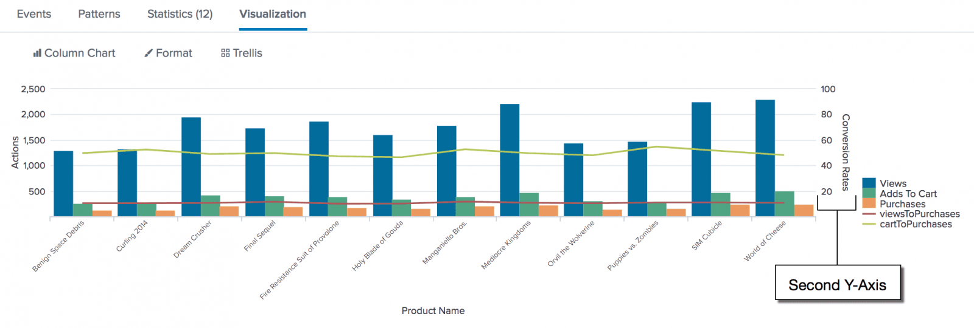
Overlay with 2nd Y Axis

Slide 51
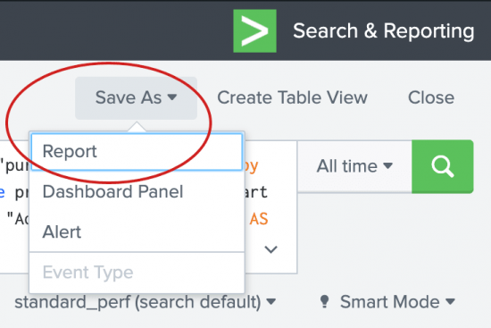
Saving a Chart as a Report

Slide 52
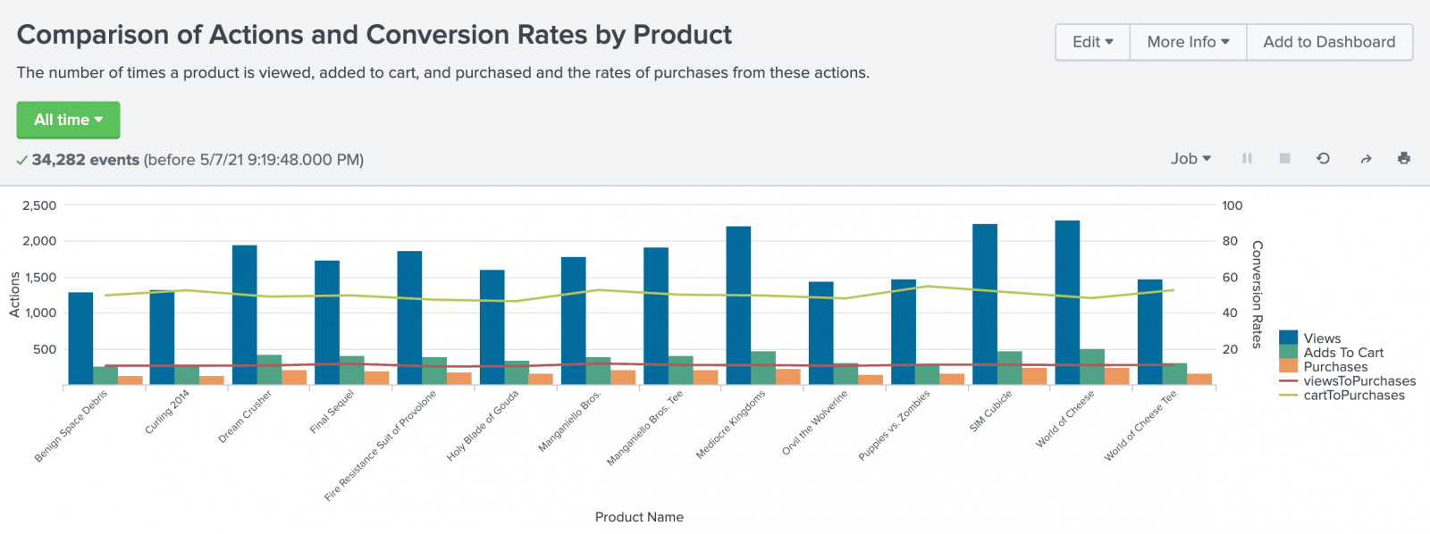
Running the Report

Slide 53
What We Have Dono with Splunk
Aggregated Sales Transaction data with local Product ID to Name mapping
Enabled real-time reporting from live Sales Transaction data
Automated the filtering, reporting, and charting
Shared our work through the organization

Slide 54
Licenses
Get a student license for Splunk
https://www.splunk.com/en_us/about-us/splunk-pledge/academic-license-application.html
For Next Week
Get your student license for Tableau
https://www.tableau.com/academic/students
There will be no graded assignment this week

Slide 55
Reminder: Look for Interesting Examples
If you find a noteworthy chart example, good or bad, send it to me:
To: robert.Nicholson@sjsu.edu
Subject: DATA 230 Example
Explain why you think it’s noteworthy
If I use it as a class example, I’ll give you 25 points (~1/4 of a homework assignment)

